Slide 1
SUPPORTING PEOPLE IN RURAL AREAS: HIDDEN HOMELESSNESS AND LIMITED INFASTRUCTURE
BREAKOUT SESSION
With Viv Griffiths from Homeless Link and Henry Meacock from St Petrocs

Slide 2
FLOW OF THE SESSION
  Setting the scene: Viv Griffiths, Homeless Link
  A visual guide to rural homelessness: Henry Meacock, St Petrocs Cornwall
  Open mic for Q&A

Slide 3


Rural Homelessness
A hidden problem and what we’re doing about it

Slide 4

Viv Griffiths
The national membership charity for frontline homelessness services. We work to improve services through research, guidance and learning, and campaign for policy change that will ensure everyone has a place to call home and the support they need to keep it.
Practice Development Manager​
Innovation and Good Practice Team​
Rough sleeping outreach and approaches to ‘verification’​
Rural rough sleeping and homelessness​
Autumn rough sleeping snapshot estimates(MHCLG)​

Slide 5
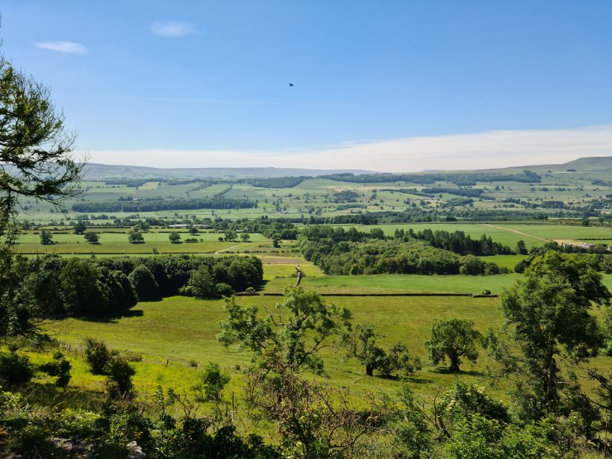
The landscape of rural homelessness​

Slide 6
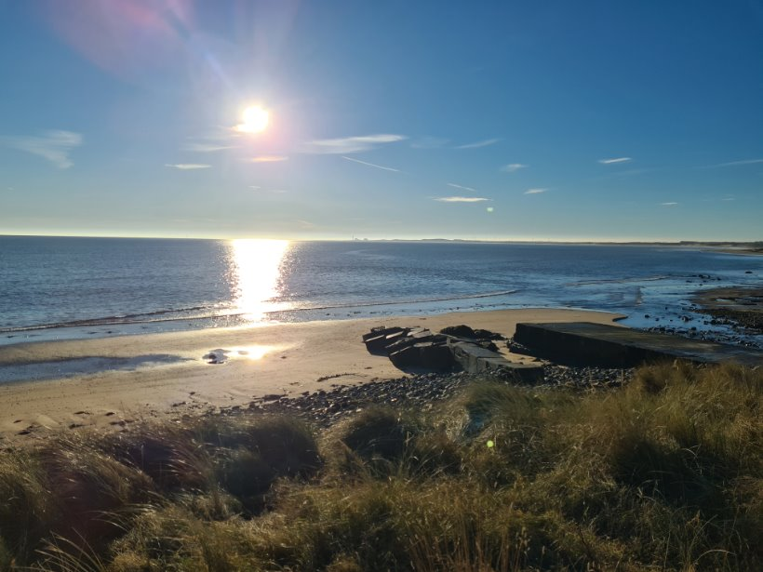
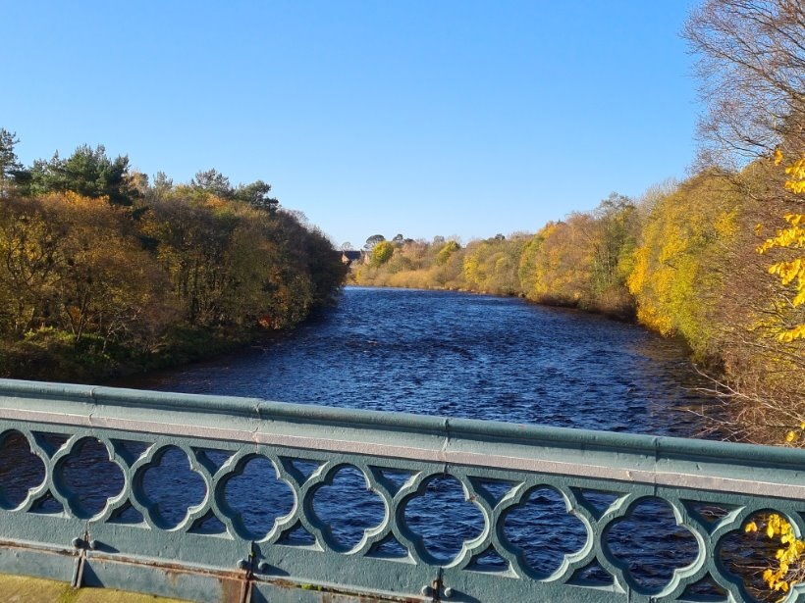
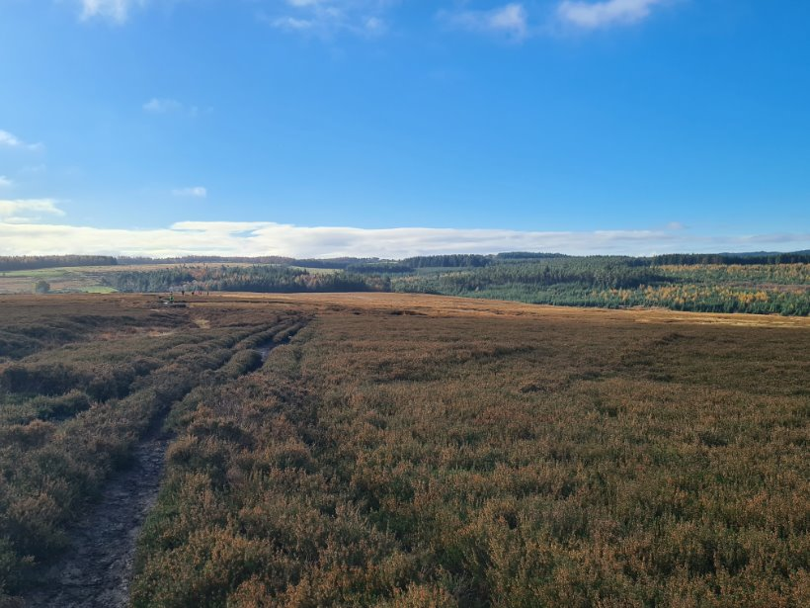
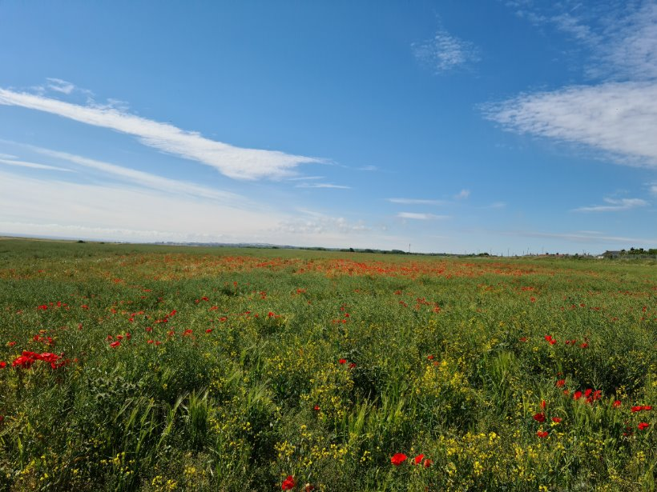
The landscape of rural homelessness​

Slide 7
Does deprivation mean urban?​
Homelessness and rough sleeping are seen as urban issues
Parts of London, Bristol, Birmingham, Leeds, Nottingham, and Brighton and Hove recorded the highest levels of rough sleeping in autumn 2025
Somerset and Cornwall were also in the top 10
Impression of rural affluence
Cotswolds
Richmondshire
Forest of Dean
County Durham
Wisbech
Vs

Slide 8

What are the drivers of rural
homelessness?​
Employment - low paid, hospitality, tourism, care-work, agriculture – most zero hours, many only seasonal
Affordability – limited supply of all housing, just 8% of homes in rural areas are affordable, compared with 17% in urban areas
Funding - 65% less central govt funding for rural areas under previous govt, current Fair Funding Framework heavily weighted towards urban deprivation, local authorities in ‘predominantly rural authorities are more likely than not to experience decreased in core spending power.’
Distance – rural local authorities tend to be geographically large and spread out, Cornwall 1375 sq mi, Somerset 1333 sq mi, North Yorkshire 3103 sq mi, Herefordshire 842 sq mi, little public transport provision
Services – difficult to access for those in need, difficult to deliver for frontline organisations

Slide 9
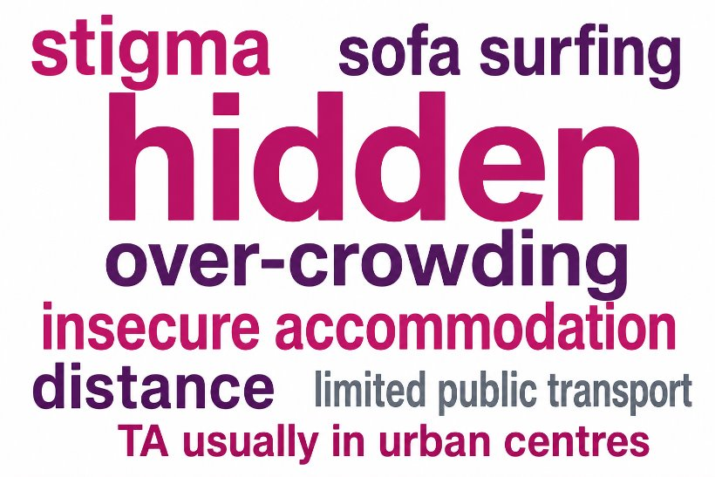
Out of sight, out of mind
Why are people experiencing homelessness and rough sleeping in rural areas not more visible?​

Slide 10
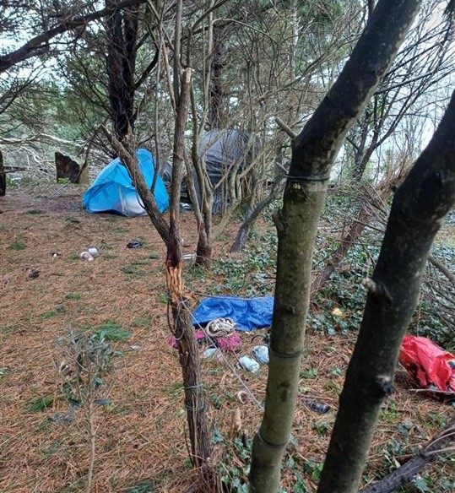
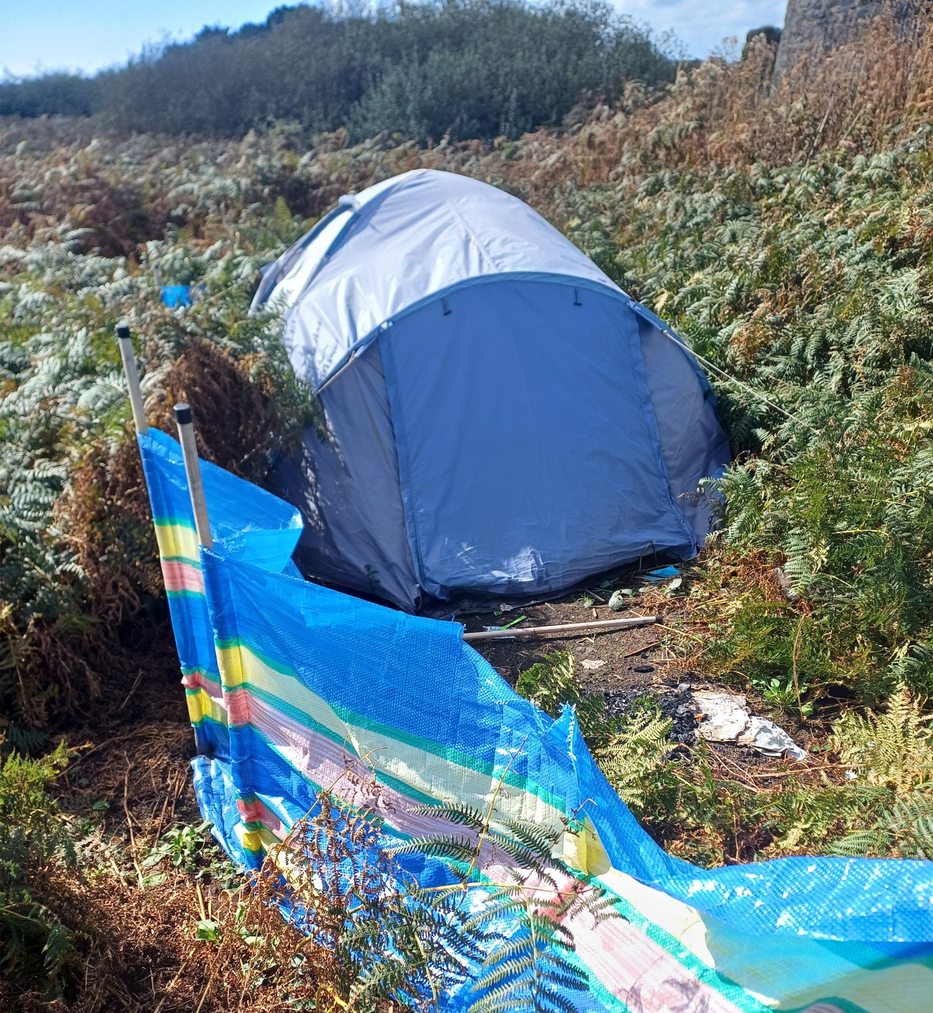
Out of sight, out of mind
Photo credit: Shirley Hilton Central Rough Sleeper Resettlement Team Manager, Cornwall

Slide 11
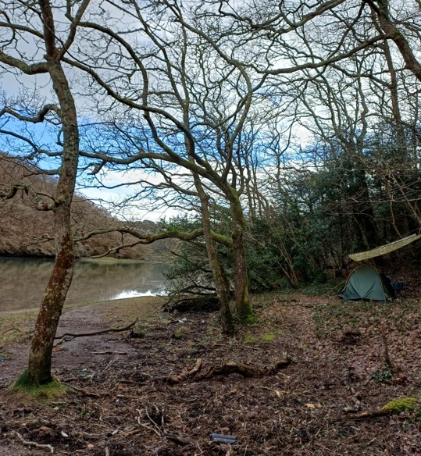
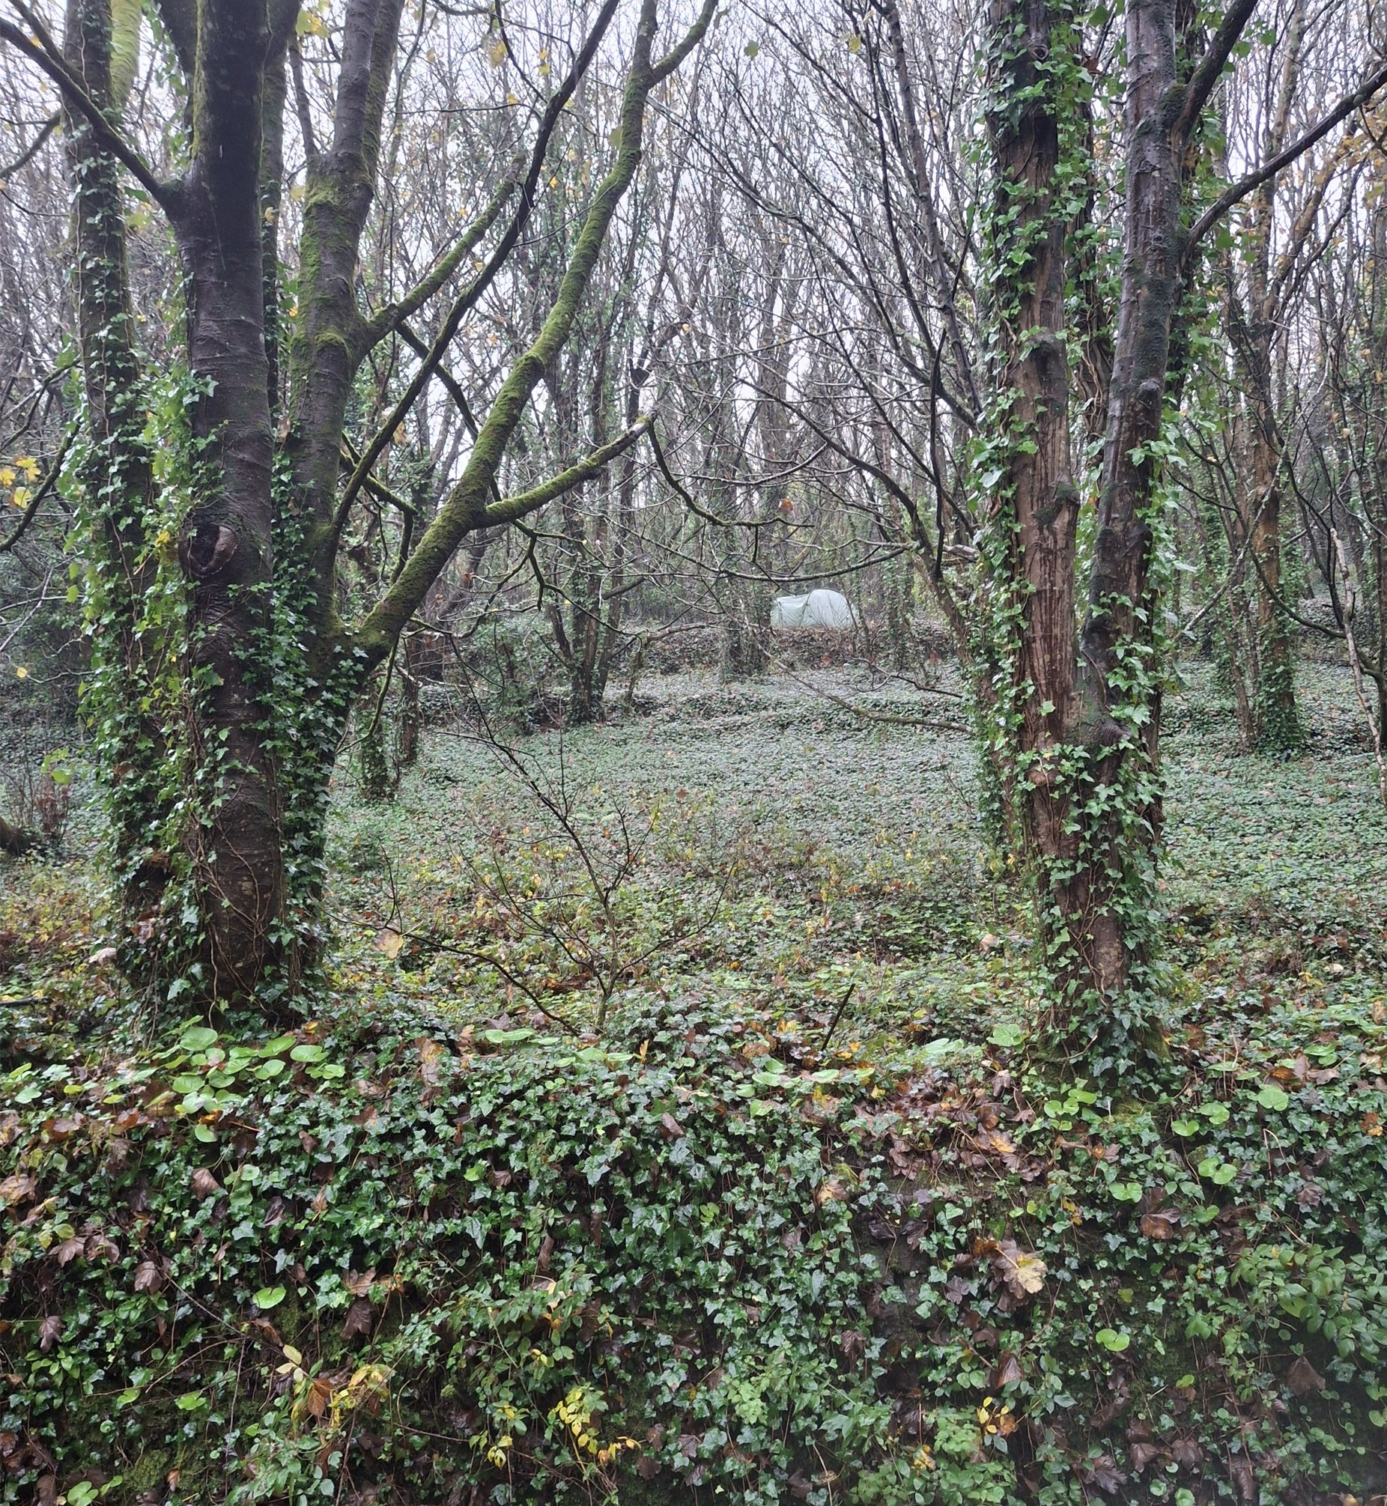
Out of sight, out of mind
Photo credit: Shirley Hilton Central Rough Sleeper Resettlement Team Manager, Cornwall

Slide 12

What are we doing about it?​
Rural Homelessness Advisory Group (Rural Services Network, English Rural, Homeless Link, P3, St Basil’s, Porchlight, National Housing Federation, ACRE, Crisis)
A census of rural homelessness and rough sleeping
  Homeless Link, University of Kent, P3
  Inspired by the Women’s Rough Sleeping Census
Influencing MHCLG Outreach Toolkit
Lobbying for a rural-focused session at the
APPG on Ending Homelessness

Slide 13

What we do
Homeless Link is the national membership charity for frontline homelessness services. We work to improve services through research, guidance and learning, and campaign for policy change that will ensure everyone has a place to call home and the support they need to keep it.
homeless.org.uk
@HomelessLink

Slide 14
SUPPORTING PEOPLE IN RURAL AREAS: HIDDEN HOMELESSNESS AND LIMITED INFASTRUCTURE
BREAKOUT SESSION
With Viv Griffiths from Homeless Link and Henry Meacock from St Petrocs

Slide 15


Slide 16

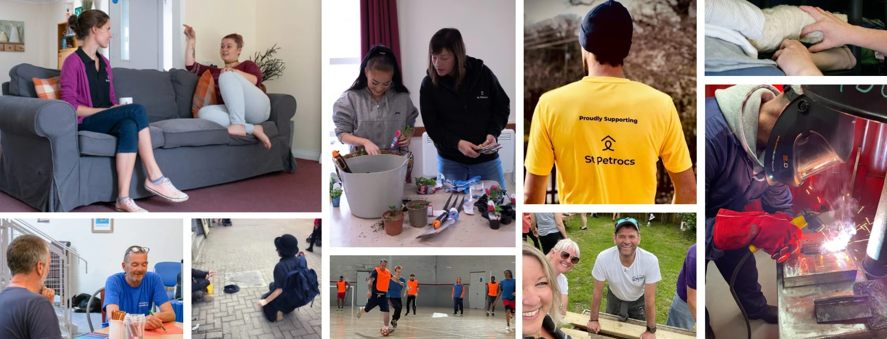

Slide 17
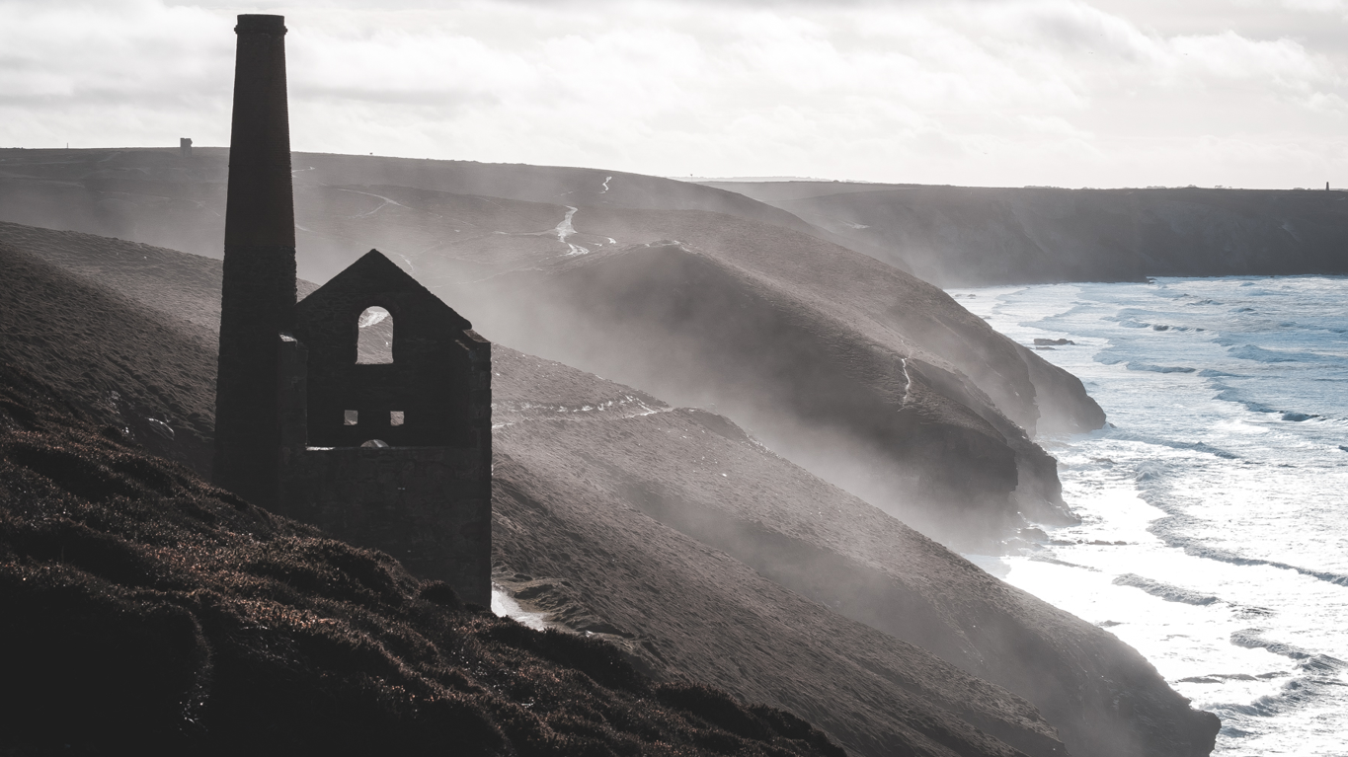

Slide 18
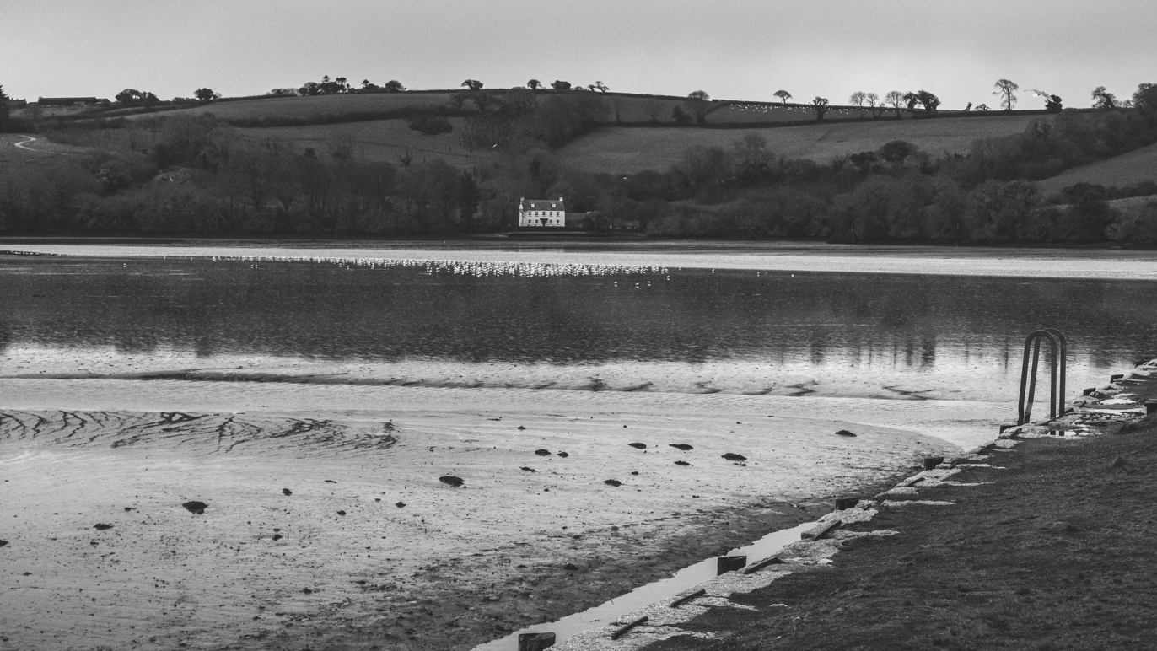

Slide 19
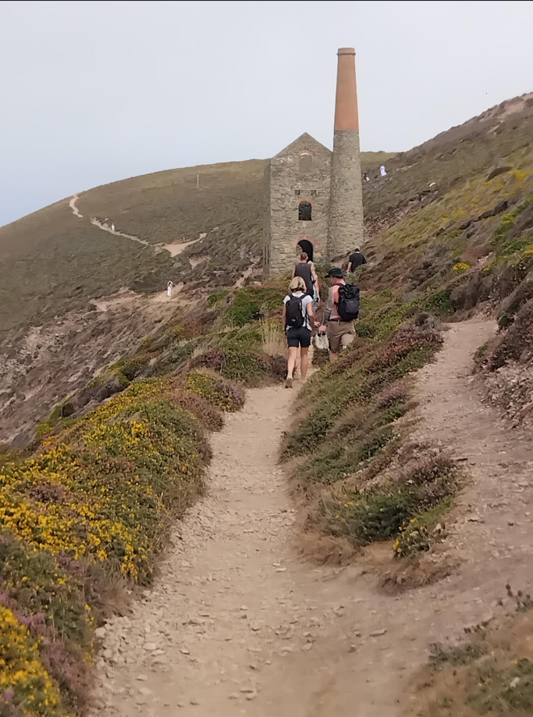
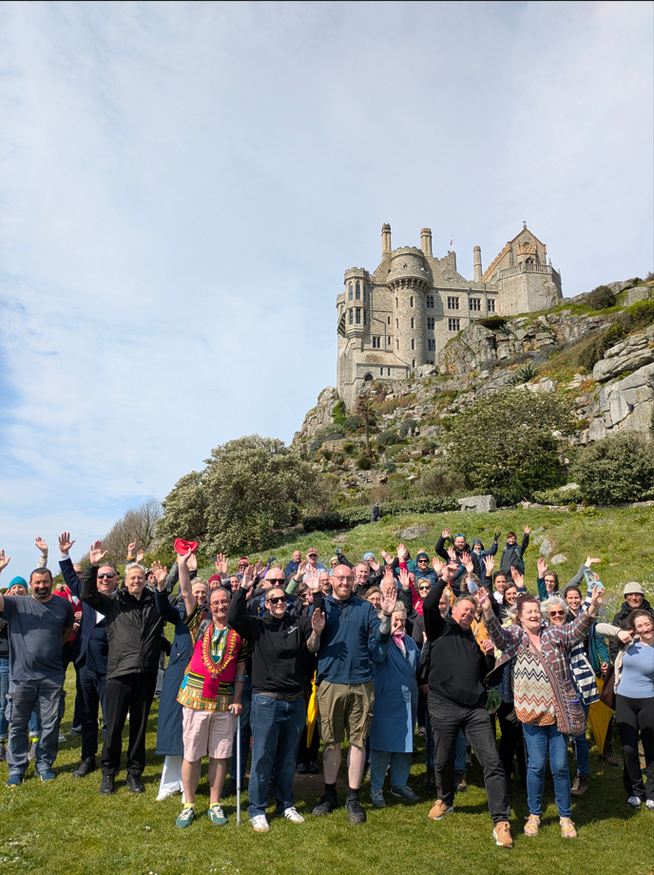

Slide 20
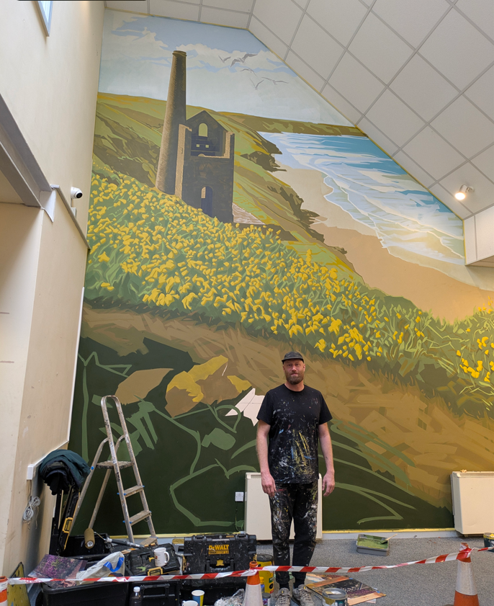

Slide 21
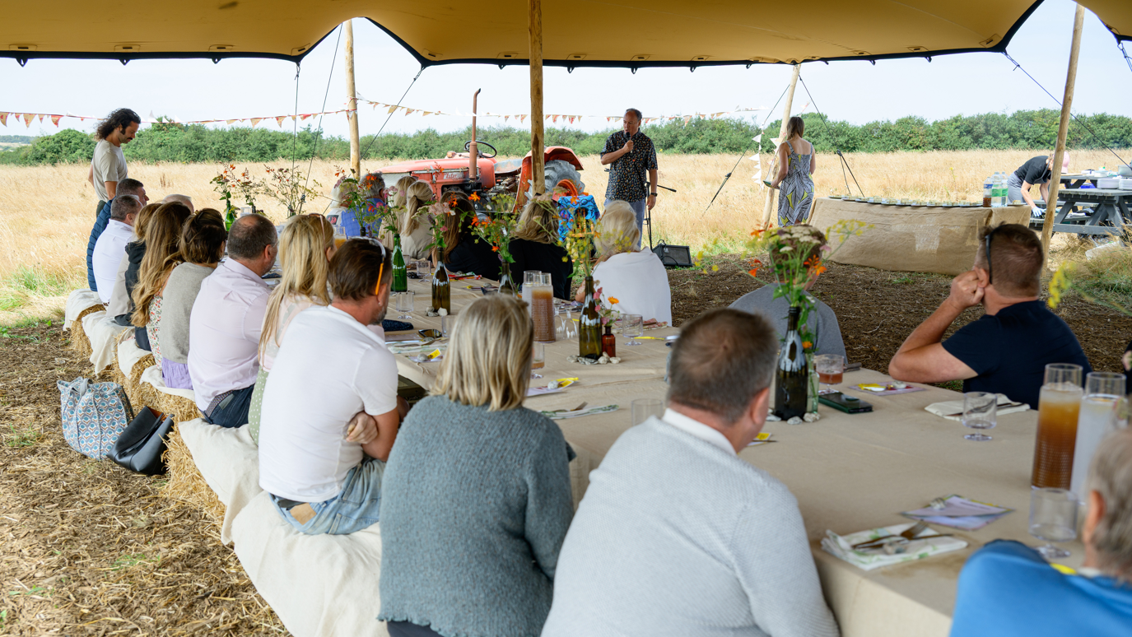

Slide 22
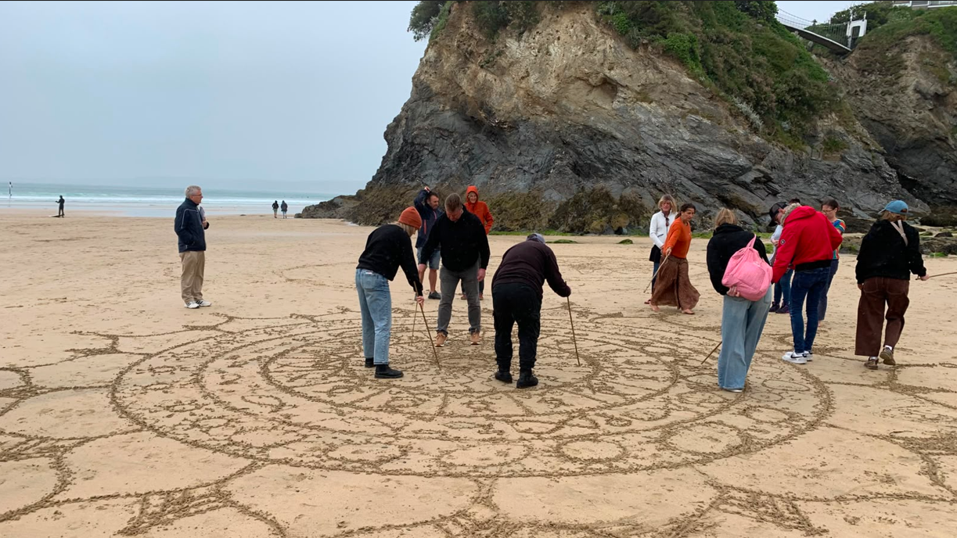

Slide 23


