Slide 1
Prevention under pressure - Navigating the prevention agenda as VCFS providers
BREAKOUT SESSION
With Independent Researcher Becky Rice and Laura Bernard, The Passage

Slide 2

TODAY'S SESSION
Introduction
James Smalley, Impact Manager, Housing Justice
How homelessness services are delivering prevention and the challenges they face
Becky Rice, Independent Researcher
Pushing forward on prevention: No Nights Out
Laura Bernard, Head of Strategy and Evidence, The Passage
Q&A and discussion
How are organisations responding to the prevention agenda, and what opportunities lie ahead?
FROM HOMELESSNESS TO BELONGING

Slide 3

Housing Justice and prevention – our role
Driving prevention through our own programmes
Supporting projects and local authorities
Influencing policy and investment
Our view: prevention is not a separate activity from homelessness response. For many VCFS organisations, the trusted relationship built at the point of crisis is itself a route to preventing further escalation and repeat homelessness.
FROM HOMELESSNESS TO BELONGING
Notes:
When we talk about prevention at Housing Justice, I think it’s important that we don’t frame it as something completely separate from our work on homelessness response.
We’re doing prevention work directly through programmes such as Citadel and our wider Community Integration work, and we’re using that learning to develop the Relational Practice Framework. A big part of that is understanding how relationships, trust and community connection can help prevent people’s situations escalating and support more sustainable outcomes.
We also have a role in helping projects and local authorities think about what prevention looks like in practice. That means sharing learning from the network, supporting initiatives, and strengthening the links between voluntary and community organisations, local authorities and statutory services.
And then there’s our influencing role. Through our work with government, including around Ending Homelessness in Communities Fund, we’ve been making the case for the VCFS to be recognised as an essential part of preventing homelessness and rough sleeping — not simply as additional capacity when statutory services are already under pressure.
With the right resourcing, the VCFS can extend their prevention and resettlement role, including increased casework capacity, stronger in‑reach, and earlier targeted prevention activity.
It’s also important to recognise that prevention is not always a one time activity that takes places before someone experiences homelessness. The prevention of repeat homelessness for those who face ongoing risk is a key space in which orgs in our network operate. Community connection and a safe and familiar service to return to if things start to go wrong (such as rent arrears or job loss) are key elements of the work to prevent further escalation, support a positive move-on and reduce the risk of someone returning to homelessness.
That leads us onto the role our Network plays in delivering preventative support, and what the wider trends across HJ’s membership tell us about that work.

Slide 4
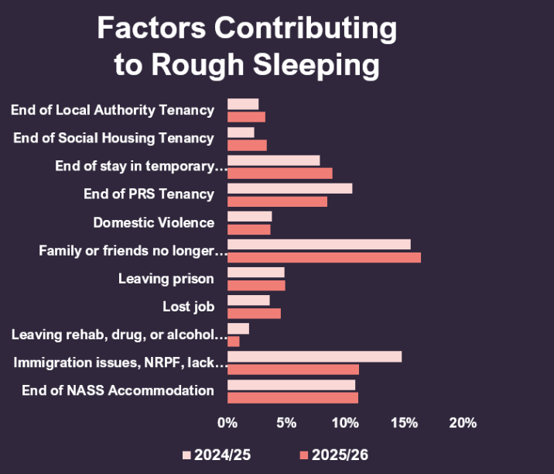
Prevention – Everyone’s role
We can see these as potential opportunities for prevention across the wider system
FROM HOMELESSNESS TO BELONGING
Notes:
Looking at the network, I think we can see quite a significant evolution away from a narrow understanding of what a shelter or faith/community homelessness organisation does. We’re increasingly seeing organisations providing day services, outreach, community hubs, advocacy, tenancy sustainment and wider support alongside accommodation.
But our data also gives us an interesting way of thinking about where prevention opportunities sit across the wider system.
Our factors contributing to rough sleeping data shows where people were coming from immediately before entering services. We see people leaving NASS accommodation, temporary accommodation, prison, local authority and social housing, and rehabilitation.
So, for example, 12% of guests in this dataset had been in NASS accommodation immediately beforehand, 9% had left temporary accommodation, 5% had left prison, and smaller proportions had left local authority or social housing or rehabilitation.
We obviously can't say from this data alone that homelessness could have been prevented in each of these cases. But it does highlight points in the system where there are.
And I think that's an important role for HJ. We shouldn't see prevention simply as something that VCFS needs to do better. There are opportunities for local authorities, housing providers, prisons, asylum accommodation providers and other agencies to identify risk and intervene before someone reaches rough sleeping.

Slide 5
Prevention – The Network’s role
From crisis response to prevention and stability - Community-led services are increasingly supporting people across the homelessness journey
CRISIS | STABILITY | PREVENTION
Safe accommodation | Tenancy sustainment | Early intervention
Outreach & immediate support | Casework & advocacy | Trusted place to return to
Crisis response | Health & specialist support | Preventing repeat homelessness
 | Community connection | Support before crisis escalates
BUT they need to be properly resourced and supported to do so!
FROM HOMELESSNESS TO BELONGING
Notes:
At the same time, our network is often the organisations that catches people when those earlier opportunities have been missed. That's where the trusted relationship becomes really important — helping prevent a crisis from escalating, supporting someone into accommodation, and potentially preventing them from returning to homelessness.
Faith and Community-led homelessness provision has evolved significantly beyond a model focused primarily on crisis accommodation. Shelters, day services, community hubs and other voluntary, faith and community organisations now provide a much broader range of support, including intensive casework and advocacy, tenancy sustainment, healthcare and mental health support, outreach, social connection and opportunities for statutory and specialist services to provide in-reach. Increasingly, these services are embedded within their local communities and provide a trusted first point of contact for people experiencing or at risk of homelessness.
This local, relational role also makes community-led services an important part of preventing repeat homelessness. Our day services research highlighted how having a safe, familiar place to return to — and an established relationship with trusted staff — can help people seek support early when circumstances such as rent arrears or job loss begin to put their accommodation at risk. While many services remain focused on responding to street homelessness, they are often operating where earlier prevention opportunities elsewhere in the system have already been missed, creating an important bridge between crisis response, ongoing support and prevention.
With the right resourcing, day services can extend their prevention and resettlement role, including increased casework capacity, stronger in‑reach, and earlier targeted prevention activity.
The current data also highlighted several important strategic themes:
- Positive move-on alone does not guarantee long-term housing stability, with a significant proportion of guests
returning to homelessness despite previously achieving a positive move-on outcome.
- Supported accommodation remains the dominant route out of homelessness, particularly outside London, highlighting both its importance and the need to explore alternative community-based support models.
Longer stays continue to be associated with better outcomes, reinforcing the value of relationship-based support and stabilisation.
The data points to a shift from measuring success as simply “moving people on” to understanding what helps people sustain that move and reinforces the need for a broader, more preventative approach to homelessness provision. Longer stays, relationship-based support and access to community services all have a role to play in building stability and preventing repeat homelessness. This reinforces the value of a more joined-up model in which accommodation is combined with accessible, trusted community-based support — both during a period of homelessness and afterwards.

Slide 6
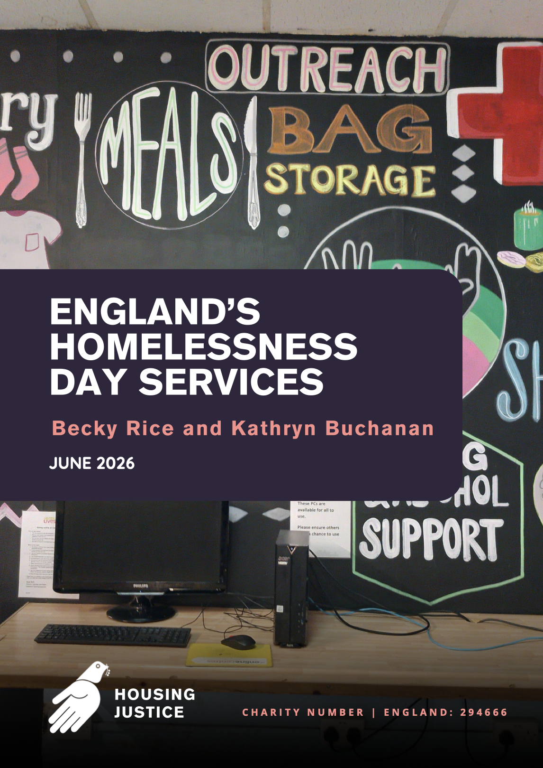
HOW HOMELESSNESS SERVICES ARE DELIVERING PREVENTION
FROM HOMELESSNESS TO BELONGING
Notes:
Drawing on the report and policy and literature around prevention

Slide 7
A GROWING
TENSION
PREVENTION POLICY AGENDA
A shared goal across public policy
Legal and earlier intervention (HRA 2017)
Prevention as routine and person-centred
A policy and academic “prevention turn” – an “era of prevention”
Funding opportunities for prevention
ESCALATING HOUSING AND HOMELESSNESS CRISIS
All forms of homelessness ↑
Spending on crisis intervention ↑
Access to housing in all sectors is tighter
VCFS services seeing increased need and complexity
Wider funding environment very tough
FROM HOMELESSNESS TO BELONGING

Slide 8
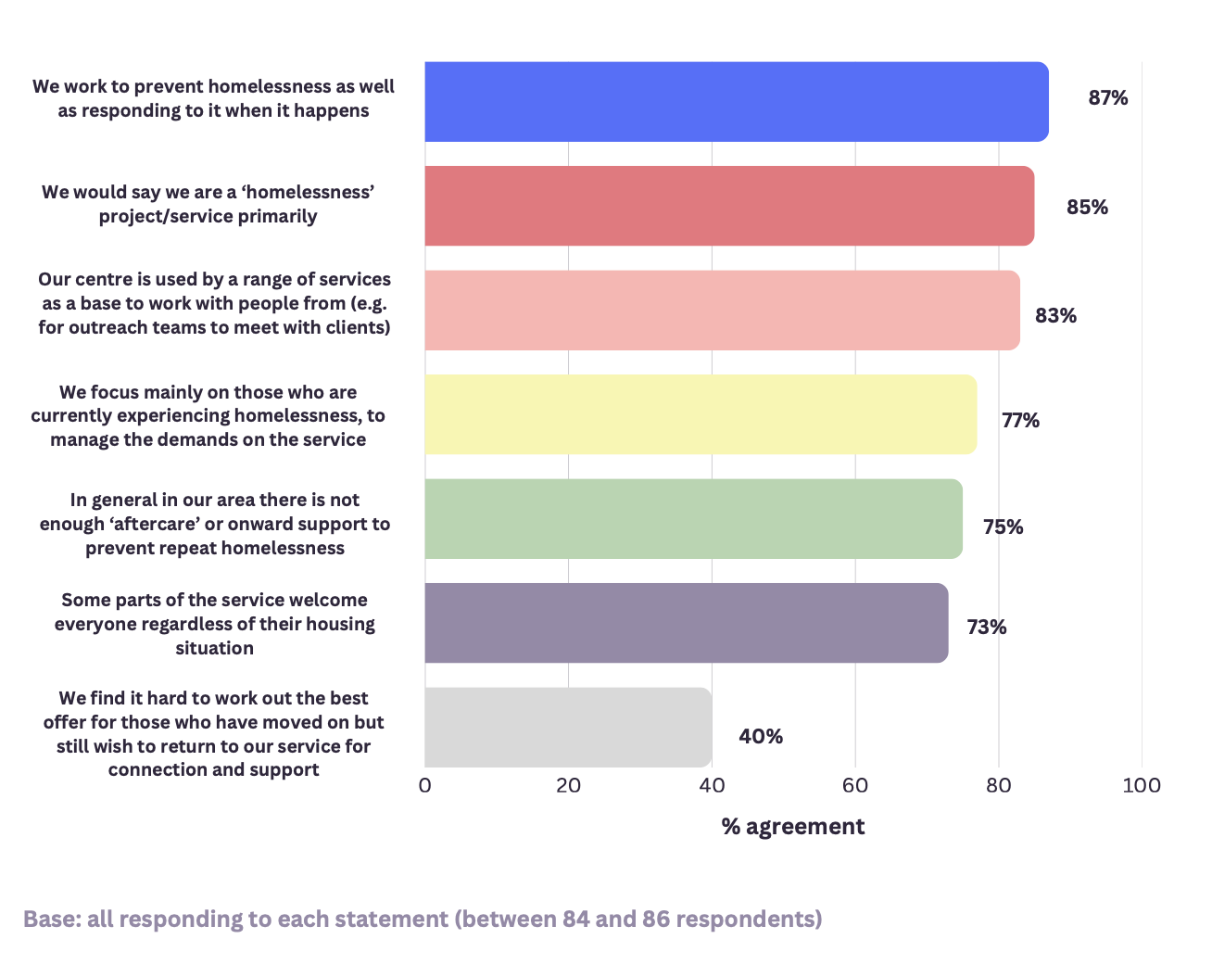
% agreement with statements about respondent’s service
87% work to prevent homelessness as well as respond
77% focus mainly on those currently experiencing homelessness to manage the demands of the services
When filling a gap for essential services under tight funding – how do you shift ‘further upstream’?
FROM HOMELESSNESS TO BELONGING

Slide 9
A broad consensus
VCFSs operate in a space where prevention opportunities have been missed
  Many expressed desire to broaden prevention
  No dispute that prevention is better than cure
  BUT – unique and core contribution is often around street homelessness
  Everyone has a unique role to play
“We'd like to see a shift for all agencies to be able to work more in the prevention area rather than the response and crisis management.” (Survey respondent)
FROM HOMELESSNESS TO BELONGING
Notes:
Organisations often expressed a desire to broaden their prevention work but regarded their unique and core contribution to street homelessness as a priority over tenancy sustainment and earlier prevention work. (Day services report)

Slide 10
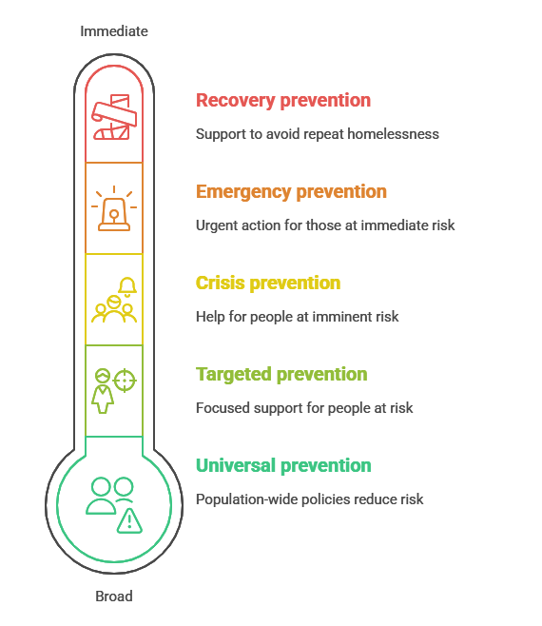
The language of prevention
“In talking about prevention, it's really important to be clear about what this actually means as it's a broad term with a number of potential interpretations….We are interested in preventing homelessness, at the point of crisis… To try and do it earlier would spread our resources far too thinly.” (Survey respondent)
Fitzpatrick, S, Mackie, P. & Wood, J. (2021). Advancing a Five-Stage Typology of Homelessness Prevention. International Journal of Homelessness, 1(1), 79-97.
FROM HOMELESSNESS TO BELONGING
Notes:
Why it matters – by working with the current language around prevention its possible to place services within the prevention framework
Enables services to demonstrate relevance to funders and ID opportunities to expand prevention work
And articulate the gaps and weaknesses in line with the prevention agenda
Crisis prevention responds when homelessness is imminent; often defined as within 56 days under the Homelessness Reduction Act.
When we talk about upsteam in the homelessness world its often moving from emergency to crisis rather than Targetted approaches

Slide 11
The language of prevention
Non recurrent
Brief
Brief / Rare
Rare
Rare
A key policy framework is the goal to make homelessness ‘Rare Brief and Non-recurring’
Started in Rough Sleeping
Extended to all homelessness
Ministry of Housing, Communities and Local Government (2025). A National Plan to End Homelessness. London: Ministry of Housing, Communities and Local Government. Available at: https://www.gov.uk/government/publications/a-national-plan-to-end-homelessness/a-national-plan-to-end-homelessness
FROM HOMELESSNESS TO BELONGING

Slide 12
VCFS homelessness services and emergency prevention
Preventing ongoing homelessness
Making it as brief as possible
Responding to those already experiencing or facing rough sleeping
Mechanisms
Identify best route out of homelessness
Refer and link to systems – council / other housing / outreach
A place of safety, trust and relationship building
Connecting via in-reach
FROM HOMELESSNESS TO BELONGING

Slide 13
VCFS homelessness services and emergency prevention - health
Harm minimisation and preventing escalation of ill health / risk of harm
Doesn’t fit as neatly into the models but key area of impact
Usually targeted to those experiencing homelessness
Mechanisms
Food, showers, laundry – for physical and mental health
In-reach to health and substance services
From lived experience interviews
  - Structure/degree of normality for those living with addiction
  - Reducing mental health risks of desperation and isolation
Role in safeguarding – the people with ‘eyes on’ a vulnerable population
FROM HOMELESSNESS TO BELONGING
Notes:
ne of those interviewed while accessing a day service
explained that when he was rough sleeping in an area without a day service, he became very
underweight as he simply was not able to access enough food.
Health professionals highlighted
that without wound care and nursing input, those rough sleeping are at higher risk of
infections, which can prove fatal

Slide 14
VCFS homelessness services and recovery prevention
Preventing repeat homelessness
Making it non-recurring
Mechanisms
VCFS services - trusted, accessible service to return to when things go wrong
Ongoing community connection – belonging, routine, trusted relationships
Some services offering more structured tenancy sustainment – others keen if resources allow
FROM HOMELESSNESS TO BELONGING
Notes:
Key area ID in the research
reduce isolation and maintain stability once people are housed.

Slide 15
VCFS homelessness services and crisis prevention work
Crisis prevention – preventing rough sleeping for those experiencing other forms of homelessness
Earlier prevention work is not delivered at scale
Role in making homelessness rare is fairly limited
Services are responsive to signposting those who are at risk of homelessness
Not widely promoted as an offer
FROM HOMELESSNESS TO BELONGING

Slide 16
Systemic challenges
Emergency prevention – making homelessness brief | Lack of onward accommodation options available to outreach and other services Groups with limited / no options Those with more complex needs who don’t have the right route out yet
Recovery prevention – non-recurring | Lack of aftercare / decent housing and income = ongoing risk of repeat homelessness People struggling / stuck in hostel accommodation Context of under resourced mental health and drug and alcohol services
Crisis prevention - rare | Local Authorities unable to provide an adequate prevention response for many people Capacity means the focus on emergency and recovery prevention
FROM HOMELESSNESS TO BELONGING

Slide 17
Opportunities
Emergency prevention – making homelessness brief | A renewed drive with PM support to take rapid action on rough sleeping
Recovery prevention – non-recurring | A strong emphasis on people experiencing rough sleeping ‘long term’ and therefore potentially resettlement and aftercare A new lens on prevention – recognition that community and connection is key and local services can provide this
Crisis prevention - brief | Examples of new prevention projects emerging which support projects to work with those at risk of rough sleeping (SELPS, Greenwich, No Nights Out)
FROM HOMELESSNESS TO BELONGING

Slide 18
Measuring prevention
Creating a theory of change which references a model of prevention
Mapping activities to prevention
Identifying mechanisms for prevention in your service - what is it about your activity that prevents homelessness
Evidence the need for prevention work
Identifying where gaps/ previous opportunities (how many of those who approach you have been to the LA for example)
Following cases up if you can - even when this is imperfect
Setting monitoring data into context with case studies / qualitative evaluation
FROM HOMELESSNESS TO BELONGING

Slide 19
Questions
How are you experiencing the prevention agenda as a VCFS service?
Does it feel relevant and appropriate to place crisis and emergency work in a prevention framework?
Where do you feel strongest in terms of prevention?
Are there any realistic shifts that would help you make more of a contribution to earlier prevention?
FROM HOMELESSNESS TO BELONGING

