Slide 1
Housing Justice
Faith and Community Services Annual Conference 2026
Leadership and Team building

Slide 2

Who are we?
CREATING RIPPLES OF CHANGE
Our Vision: Change makers creating a sustainable future
Our Purpose: To be courageous, compassionate and creative in facilitating transformational change

Slide 3
Today’s Objectives
Increasing self-awareness around leadership and teamworking preferences by learning about the Caplor House
Recognising and building on individual and collective strengths
Having fun and developing relationships
Do the best you can until you know better. Then when you know better, do better.
– Maya Angelou

Slide 4
Today’s Plan
Welcome and scene setting
Objectives, plan and how we will work together
Break into three groups with Rosie, Dan and Kemal
Recognising our individual and collective strengths
The Caplor House: understanding our leadership and teamworking preferences
Break @ 11.20
Summary feedback from the groups
Review and Close

Slide 5
How are we going to work together?
Give your best – fun, energy and laughter enables effective learning
Let everyone be heard and feel safe to express their views
Keep to time and no mobiles or working on other things
‘The winds are blowing’
If you want to go fast go alone. If you want to go far, go together.
– African Proverb

Slide 6
Learning Zones
Panic Zone
Stressed
Overwhelmed
Fearful
Frustrated
Tense
Learning Zone
Worried
Tired
Challenged
Supported
Motivated
Excited
Comfort Zone
Take risks
Easy
Safe
Bored

Slide 7
Groups
Move to your rooms with Rosie, Dan and Kemal
Try to be in a different room to your colleagues

Slide 8
A Strengths Based Approach
Find someone to have a ‘quick fire’ conversation with on the topic of ‘recognising and appreciating our strengths’
Think about:
When someone else recognised and appreciated a strength in you
When you recognised and appreciated a strength in someone else
How did it make you feel and what can you learn from this?
Do the best at what you are best at for the benefit of others. – Charles Handy

Slide 9
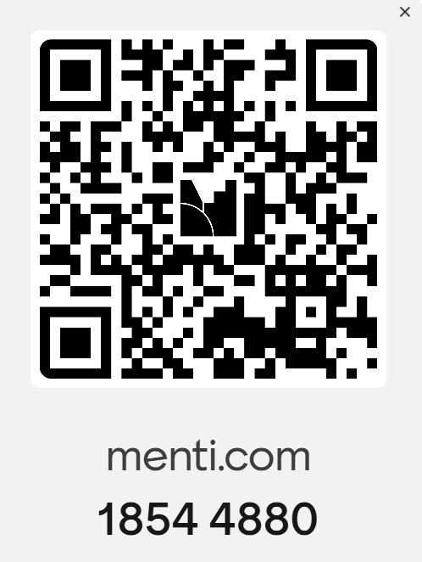
A Strengths Based Approach
Mentimeter:
What are the biggest strengths of your organisation?
What is the biggest strength of this network? (one word)
Do the best at what you are best at for the benefit of others. – Charles Handy

Slide 10
A Strengths Based Approach
Mentimeter:
Rank the following ‘culture related leadership challenges’ in order of priority:
Preventing burnout & protecting wellbeing
Staying true to values while staying open
Sharing power & valuing lived experience
Leading beyond crisis mode (including resource/funding issues)
Growing and keeping good leaders (including resource/funding issues)
Do the best at what you are best at for the benefit of others. – Charles Handy
Notes:
Preventing burnout & protecting wellbeing — sustaining staff and volunteers emotionally and practically when demand always outstrips capacity, and modelling healthy limits from the top.
Staying true to values while staying open — holding onto faith identity and mission while remaining genuinely welcoming and inclusive to people of all beliefs and backgrounds.
Sharing power & valuing lived experience — shifting from "doing for" to "doing with," and making space for people with direct experience of homelessness in how decisions get made.
Leading beyond crisis mode — creating room to reflect, learn and plan rather than permanently firefighting, so culture is shaped intentionally rather than by whatever's most urgent.
Growing and keeping good leaders — developing people, handling difficult conversations well, and thinking about succession when the team is small and stretched thin.

Slide 11
Instructions
Each person will be given 4 cards
Read the words/descriptions on the cards and decide if these describe you accurately
If they do, you may want to keep the card. If not, try to exchange the card for a card that someone else wants to give away
You must have 4 cards at all times
Exchange cards until you have 4 cards that you are happy with – they ‘suit’ you.

Slide 12

The Caplor House
Stand in corner of the ‘room’ that represents your first preference
Discuss the common characteristics that make up that ‘room’

Slide 13
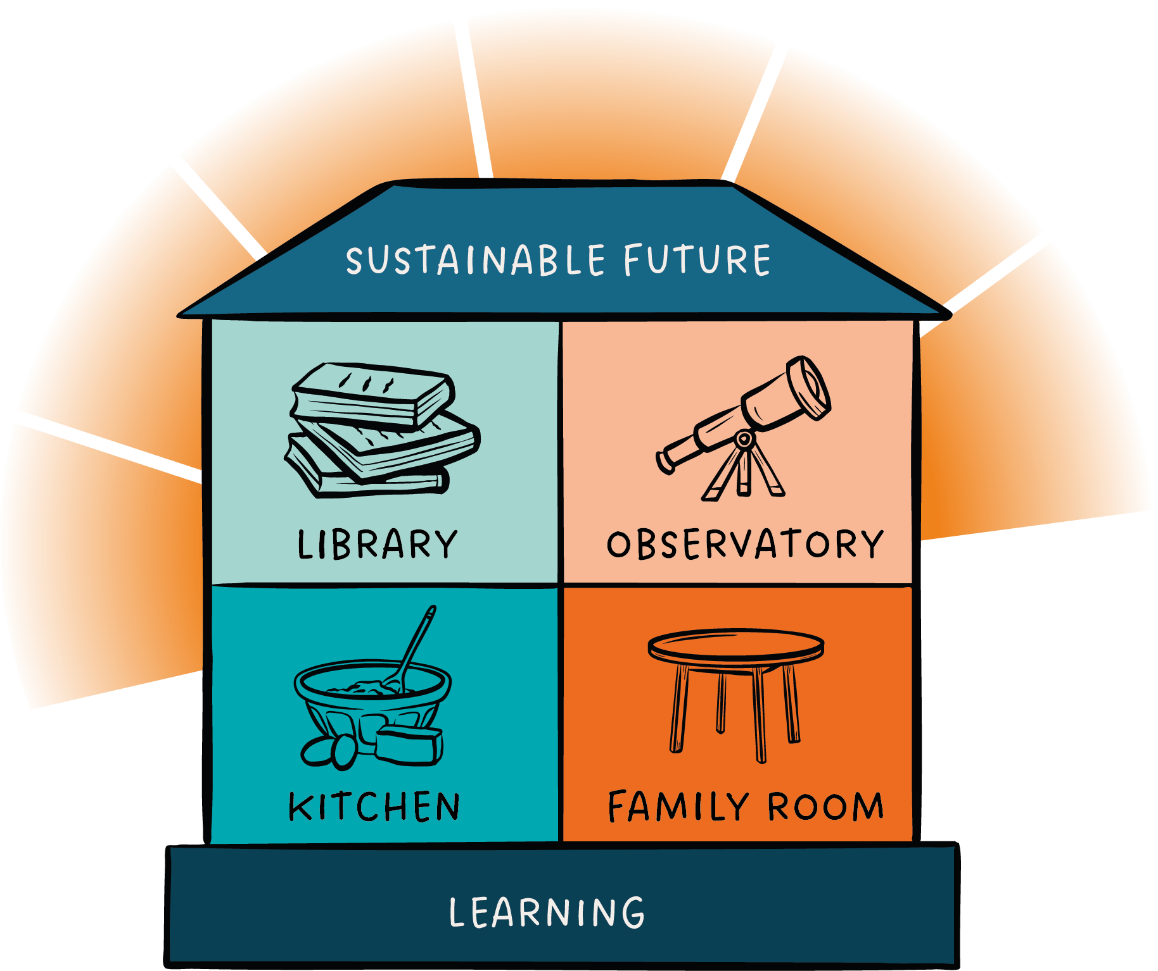
The Caplor House
Reason
and
analysis
Vision
and
innovation
Order
and
structure
Empathy
and
communication

Slide 14
The Caplor House – Strengths
Motivation: Clarity
Analytical, precise, rational, reliable, methodical, objective, inquisitive, balanced
Motivation: Meaning
Visionary, flexible, thoughtful, insightful, intuitive, creative, open minded, risk taker
Motivation: Results
Organised, driven, systematic, diligent, direct, results-focused, competitive, self-starter
Motivation: Relationships
Passionate, accommodating, enthusiastic, engaging, energising, empathic, collaborative

Slide 15
The Caplor House – Challenges
Fear: Chaos
Unemotional, academic, over critical, perfectionist, hard to please, resistant, inflexible
Fear: Lack of Purpose
Inadequate follow through, indulgent, indecisive, lacking pragmatism, volatile, easily distracted, idealistic
Fear: Loss of Control
Demanding, confrontational, arrogant, not listening, insensitive, resistant to change
Fear: Lack of Personal Acknowledgement
Impulsive, talk too much, avoid conflict, unpredictable, overly expressive

Slide 16

Walking around the house
Although everyone has their preference…
Good leaders have the capacity to work effectively in all the rooms
Knowing when to move from one to another and how to take people with them
We are all ‘leaders’

Slide 17
The Caplor House – Reflection
How can the Caplor House help us to transform our leadership – so that we can have even greater impact on housing injustice at local level?

Slide 18
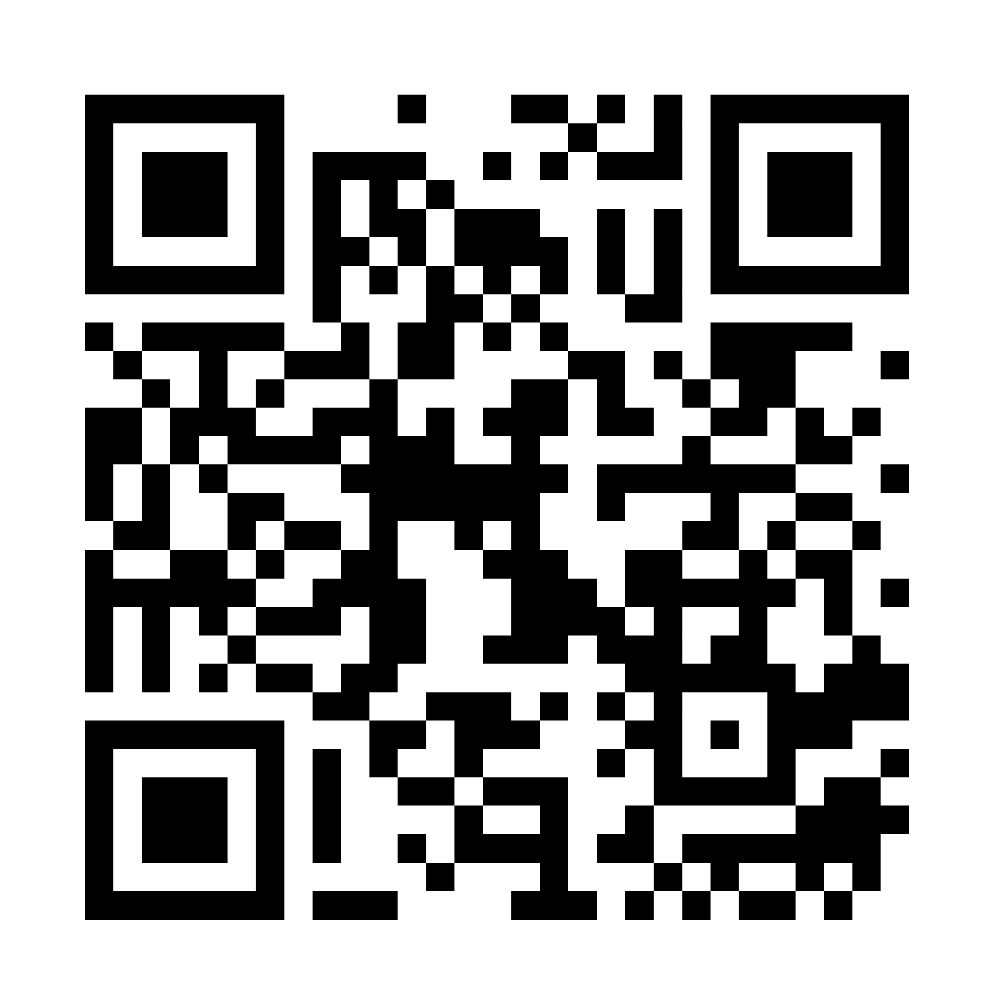
The Caplor House
Before you have a break… please share your name and your first Caplor House preference in this Google form here using the QR code

Slide 19
BREAK
Come back in 15 minutes

Slide 20
The Caplor House – Our network
21
33
16
42

Slide 21
Insights and Reflections
Summary of responses from Mentimeter and Caplor House
Conversation with a partner – what are your most important reflections based on these insights?

