Slide 1

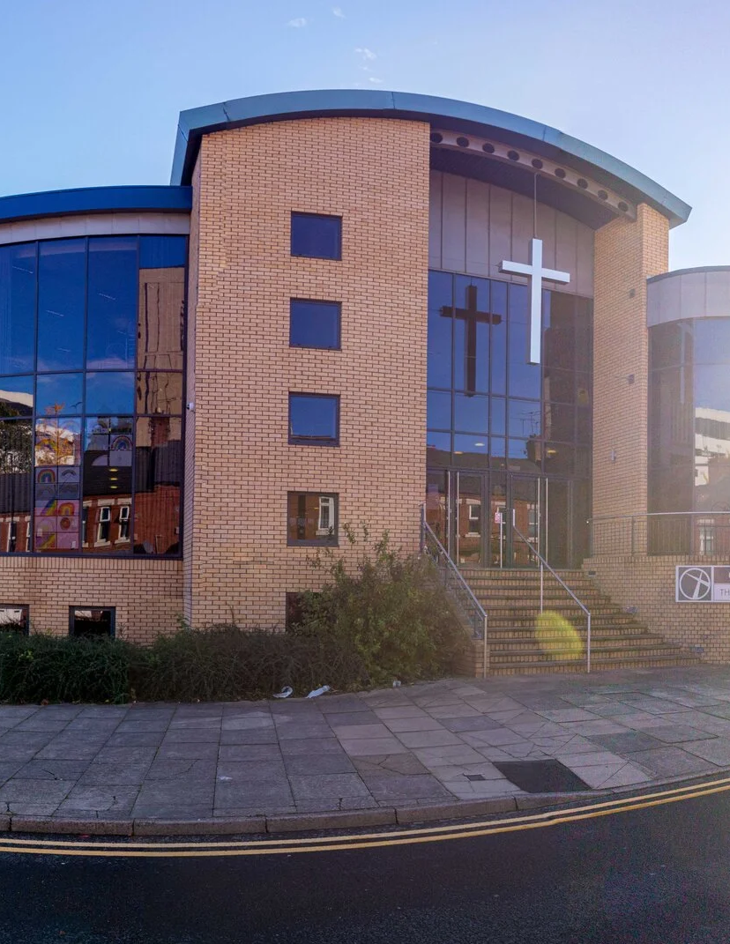
Prayer breakfast
“How do I fit in?”

Slide 2
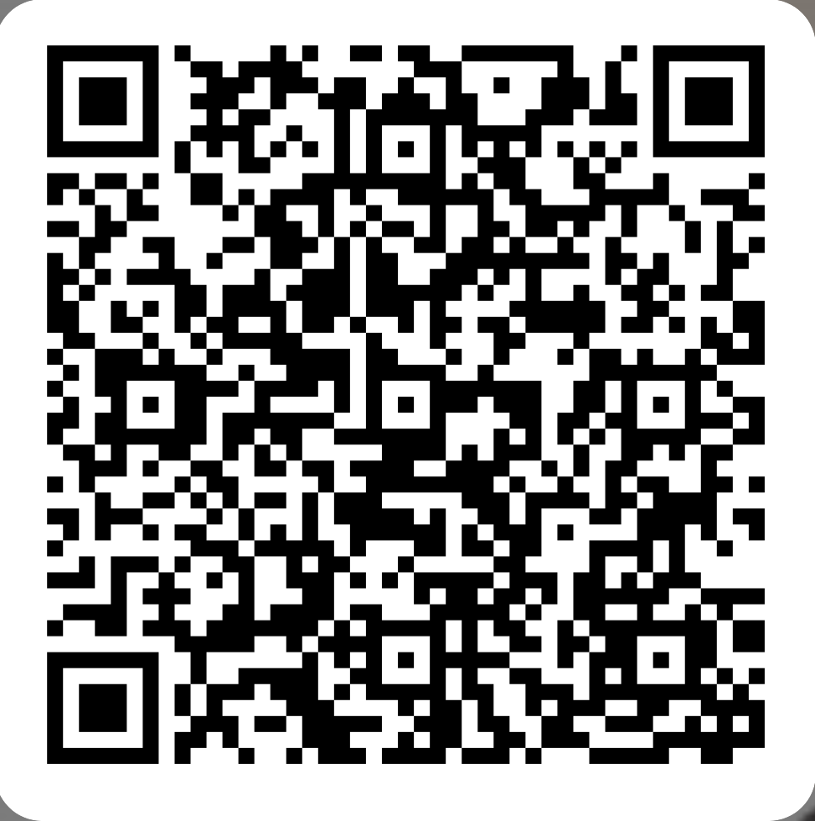
“How do I fit in?”
New online prayer space:
fill out our EOI form

Slide 3

REFLECTION
The Right Reverend Rob Wickham
Matthew 18: 1-5
Image credit: pngtree

Slide 4
MATTHEW 18; verses 1-5
¹ At that time the disciples came to Jesus and asked, “Who is the greatest in the kingdom of heaven?”
² He called a child, whom he put among them,
³ and said, “Truly I tell you, unless you change and become like children, you will never enter the kingdom of heaven.
⁴ Whoever becomes humble like this child is the greatest in the kingdom of heaven.
⁵ Whoever welcomes one such child in my name welcomes me.”

Slide 5
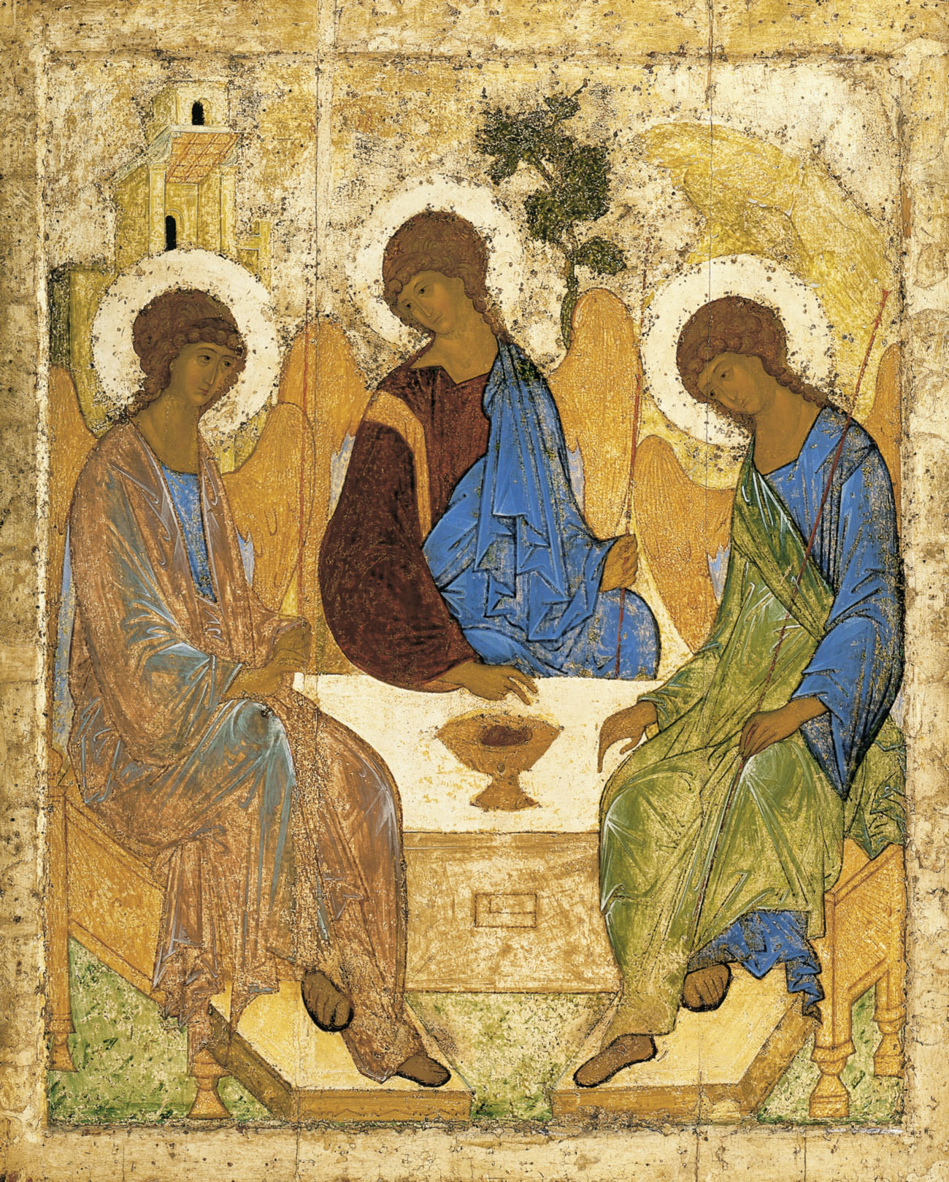
The hospitality of Abraham or The Trinity
Andrei Rublev
Image credit: Wikipedia

Slide 6

DISCUSS
In small groups, please discuss: “How do we make room for others?”

Slide 7
PRAYER TIME
Let us pray together, in silence or out loud.

Slide 8
The Lord’s Prayer

Slide 9
Thank you for coming
New online prayer space:
fill out our EOI form

