Slide 1

HOUSING JUSTICE
Data Briefing: Analysis of the
Impact Portal 2025-26
FROM HOMELESSNESS TO BELONGING

Slide 2
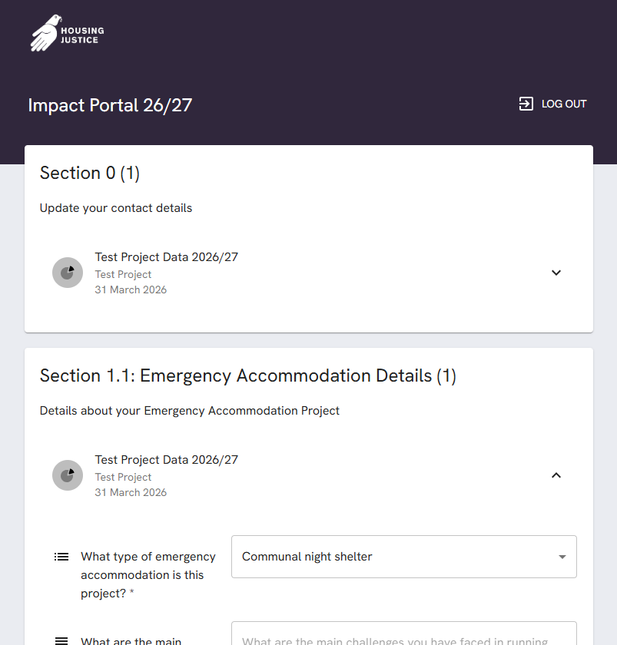
UPCOMING IMPACT PORTAL CHANGES
HJ is in the process of migrating to a new database
The new database has integration with a portal-type system which allows external users to submit information directly into it
This will replace the existing Impact Portal for 2026/27
Has potential to break up the data sections into more manageable sections
Any new questions or changes will be set out by the start of the winter season (Nov 1)

Slide 3
THE VALUE OF NETWORK DATA COLLECTION
What data would be most useful to you in demonstrating your impact?
What specific datasets would help you evidence your work?
What contextual information would make the data more useful?
How would you like HJ to present data back to you?

Slide 4
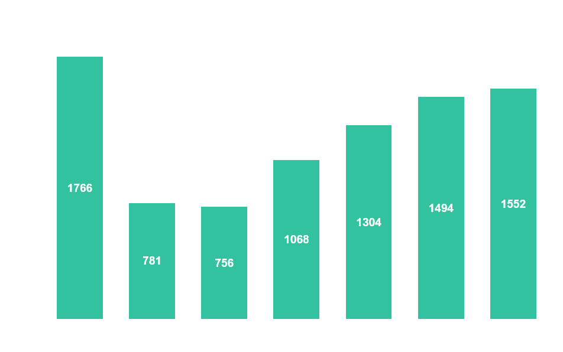

ACCOMMODATION
Notes:
Shift back towards communal beds – meeting capacity

Slide 5

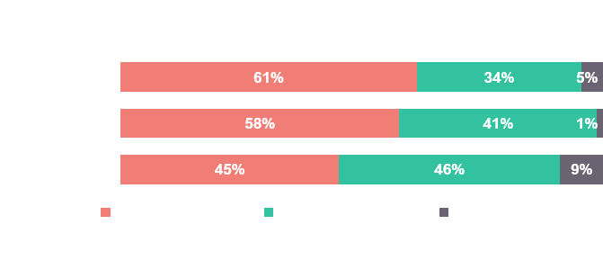
ACCOMMODATION – LDN/ENG
Notes:
The shift has been particularly pronounced in London, which makes sense with the higher need

Slide 6
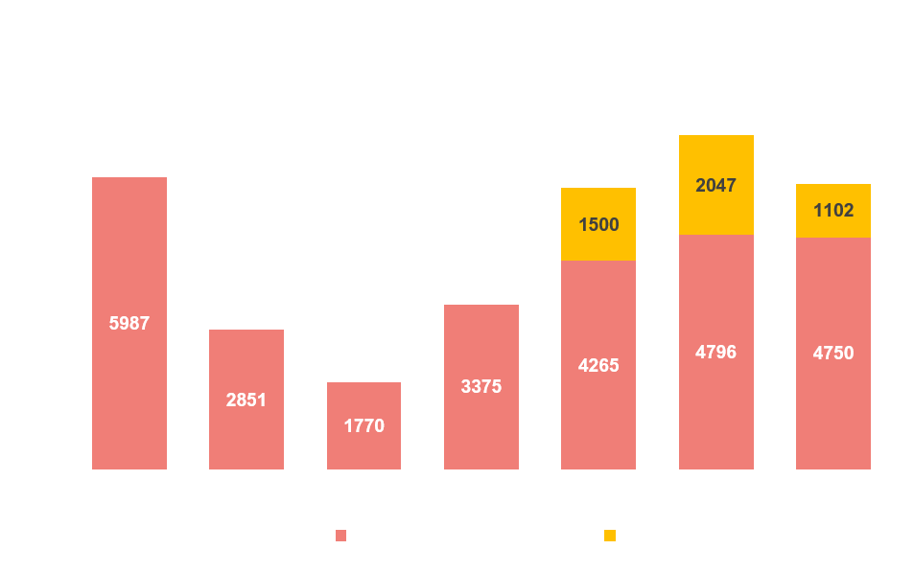
GUESTS
Notes:
Guest numbers have remained stable, non-winter guests numbers are a bit more volatile due to smaller sample size, if a few AYR shelters do not submit data it has large affects on estimates. The following data is drawn from winter guest data, partially because of this volatility in the non-winter guests but also due to us only having one year of data of the non-winter guests.

Slide 7
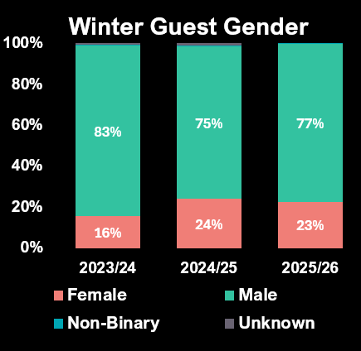

GUEST DEMOGRAPHICS
Notes:
Gender split in shelters remains similar to last year, confirming the trend towards more female guests in night shelter that we saw last year. This is from having more female-only shelters, particularly communal models where large numbers of women can be accommodated. Age grouping splits are relatively stable, with a slight downwards trajectory in younger age groups after the last few years of increases. Under 35s account for 41% of all guests

Slide 8
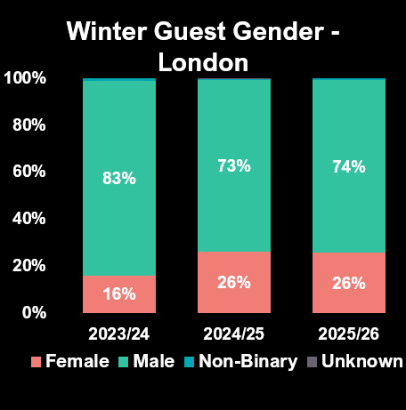
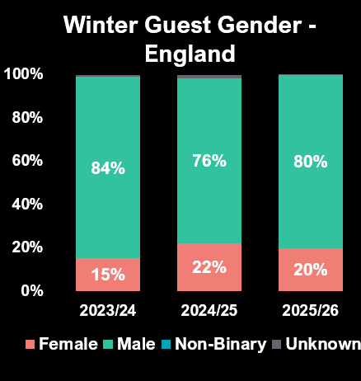
GUEST GENDER – LDN/ENG
Notes:
Gender comparisons between LDN and ENG are quite close, but LDN has 6% more female guests, perhaps aligning with that idea of female-only communal shelters.

Slide 9


GUEST AGE – LDN/ENG
Notes:
Age groups in England are a more stable than in London, we have less 26-35s in London than we have had in the last 2 years but England remains very similar. London still tracks younger with 43% under 35 compared to 38% in England.

Slide 10

NATIONALITY GROUPING
Notes:
Nationally we have a large uptick in UK Nationals and a downward trajectory for rest of the world

Slide 11
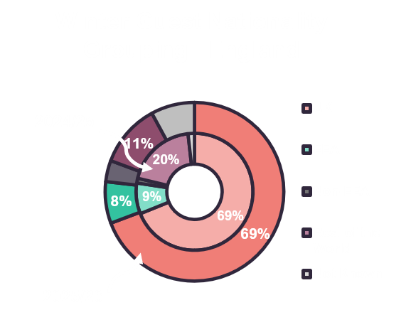
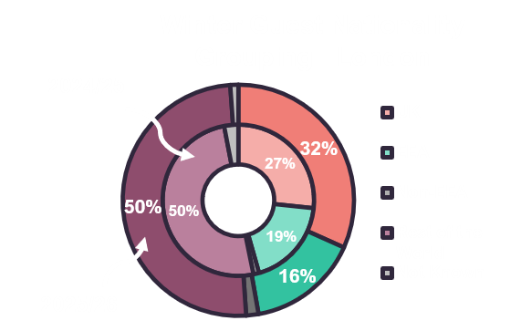
NATIONALITY GROUPING – LDN/ENG
Notes:
But when split, London’s guests are 50% rest of the world, unchanged from last year, whereas England has 11%, down from 20%. England however does have a large not known proportion this year.

Slide 12

FACTORS CONTRIBUTING TO ROUGH SLEEPING
Notes:
Factors have remained very similar but with some interesting changes, ending of PRS tenancy has fallen 3% to 8% of guests as a factor despite the presumed fallout from the run up to the renter right act taking affect. Immigration issues have also fallen 4% to 11%.

Slide 13


FACTORS CONTRIBUTING TO ROUGH SLEEPING – LDN/ENG
Notes:
That drop in PRS tenancy as a factor is seen across both London and England. Whereas Immigration issues as a contributing factor has fallen most in England.

Slide 14
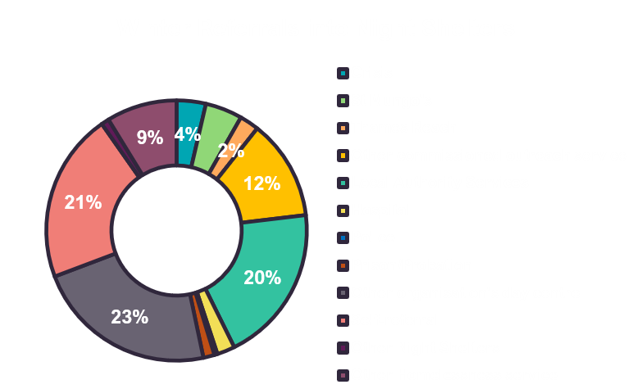
REFERRALS INTO SHELTERS
Notes:
43% of referrals into night shelters came from commissioned services, 33% came from other night shelters, other day centres or homelessness services

Slide 15
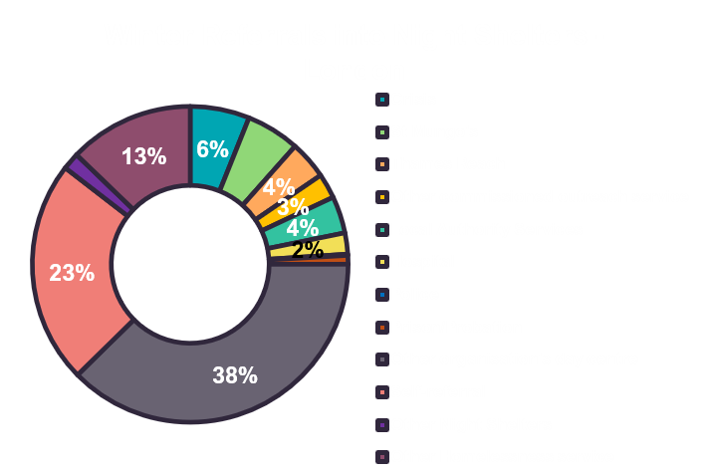
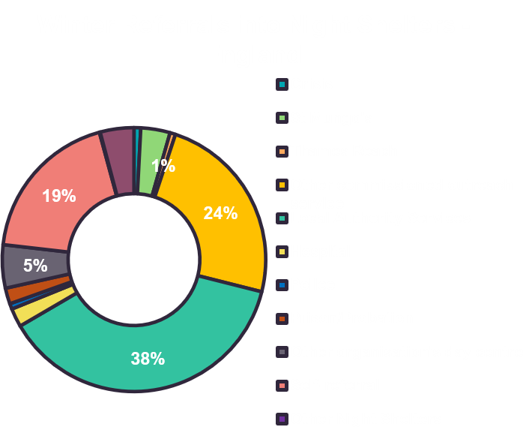
REFERRALS INTO SHELTERS – LDN/ENG
Notes:
For London 53% came from night shelters, other day centres or homelessness services compared to just 9% in England, showing the cross-over of services in London. England had a much higher referral rate from commissioned services at 68% compared to London’s 22%

Slide 16
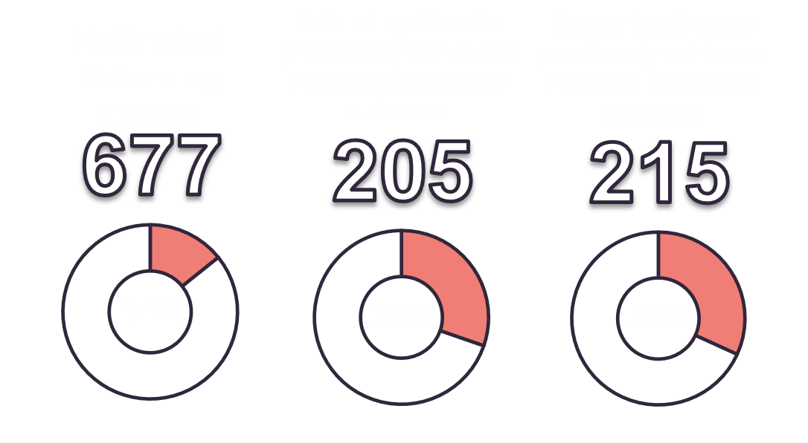
RETURNING GUESTS
Notes:
Guest who are returners to shelters from previous years are at 14%. This year we asked a new set of questions about whether returning guests achieved a positive outcome. Collectively this suggests that two thirds of returning guests did achieve a positive result.

Slide 17
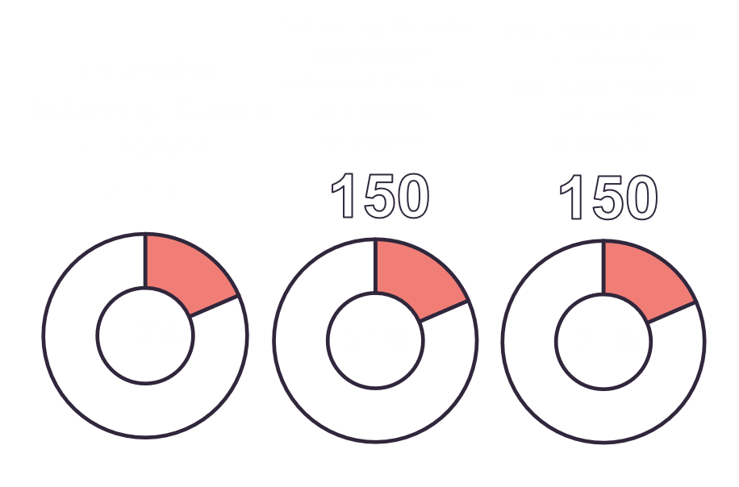
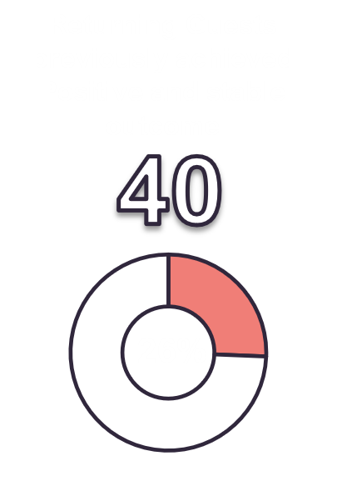
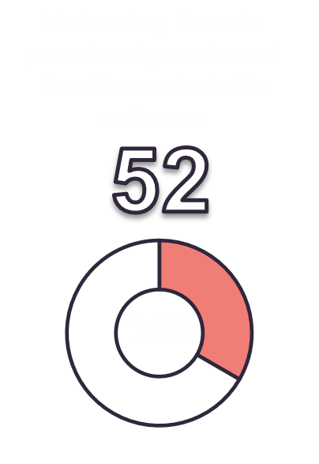
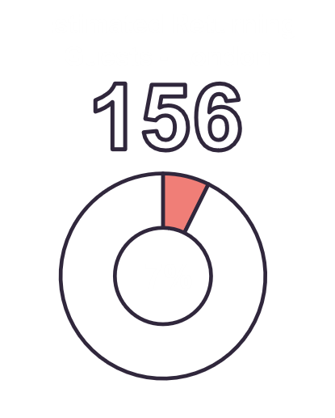
RETURNING GUESTS – LDN/ENG
Notes:
There are more returners to England shelters, but not much difference in terms of positive outcome returners.

Slide 18

LENGTH OF STAY
Notes:
Our length of stay options increased this year to cover the period beyond 29 nights. This shows some expected cliff edges particularly with communal shelters after 29-56 nights. The same pattern from previous years still stands where 20% of guests in communal shelters leave after 1-2 nights and single-room guests are likely to stay for longer periods.

Slide 19


LENGTH OF STAY – LDN/ENG
Notes:
In London shelters we’re more likely to experience a sharper cliff edge after 29-56 nights – due to shelters closing after the winter season. Communal guests in England are as likely to stay for a week as they are 1-2 nights. Single room guests in England shelters are as likely to stay a week as they are all the way through to 29-56 nights.

Slide 20

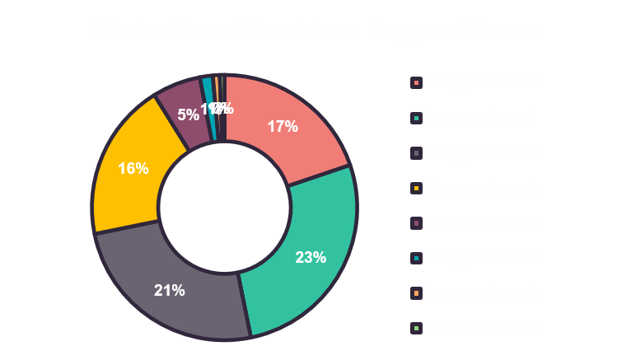
SUPPORT NEEDS
Notes:
Not much change here except a decline in mental health support needs. Complexity of need is mixed, but 60% of guests have more than 1 support need, showing the complexity.

Slide 21


SUPPORT NEEDS – LDN/ENG
Notes:
Slightly higher needs in ENG but this could be due to more fuller reporting, as anecdotally, all shelters report a high level of need. ENG higher on substance dependency and criminal justice. LDN higher on physical disability and immigration issues

Slide 22
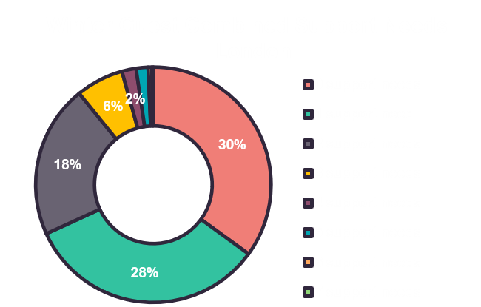
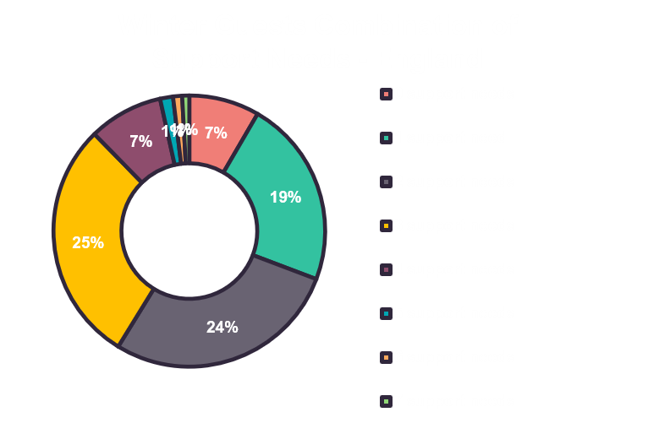
SUPPORT NEEDS COMBINATION – LDN/ENG
Notes:
Higher levels of support needs are seen in England shelters compared to London. This could be due to shelters not recording this information or set up to work with guests with complex needs or referring them to other services that are available.

Slide 23

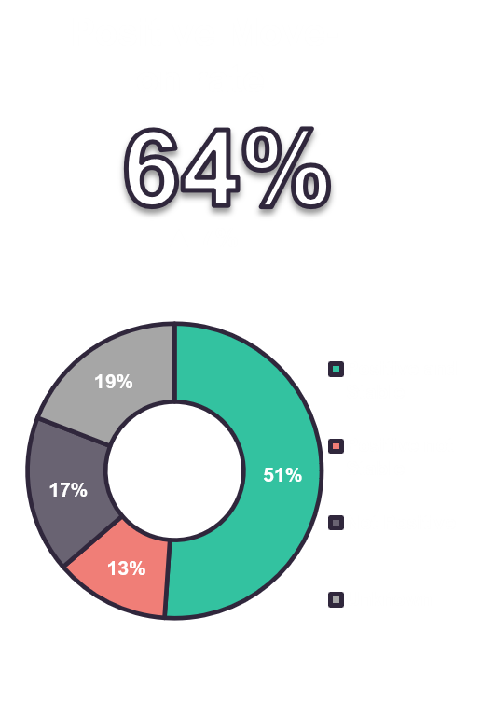
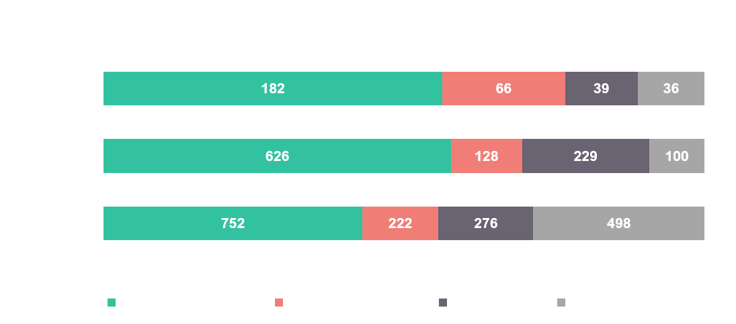
OVERALL MOVE-ON
Notes:
Positive move-on has increased by 7% and the overall 64% positive is the highest we’ve had at least since the pandemic. Communal shelters, whilst still producing less positive move-on outcomes have been where the increase has come from this year.

Slide 24

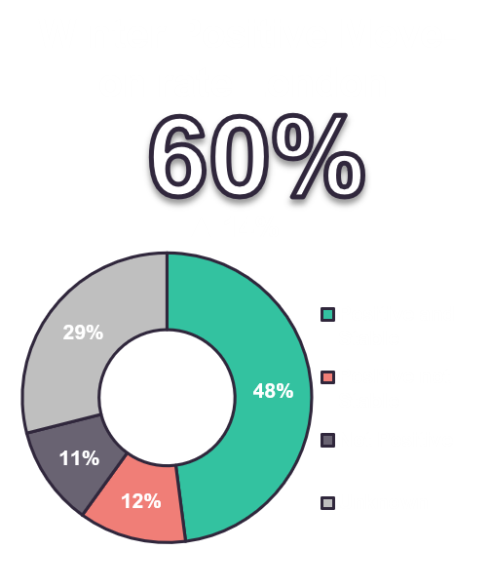
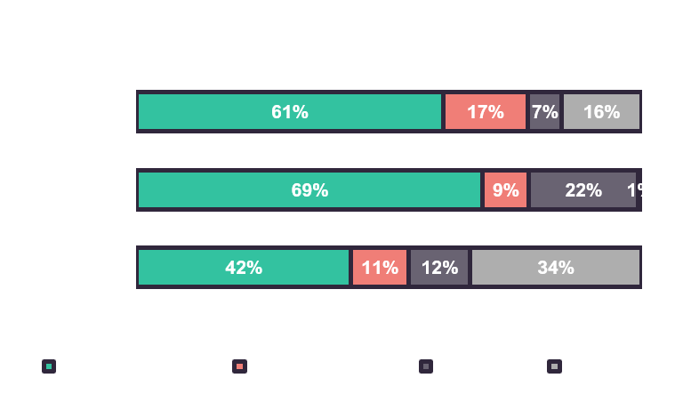
MOVE-ON - LONDON
Notes:
This is evident in the London move-on rate being up 14%.

Slide 25

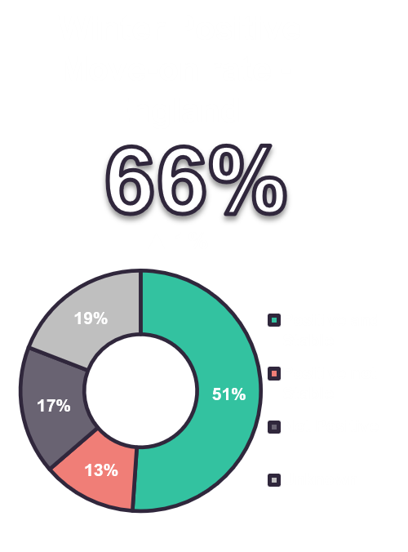
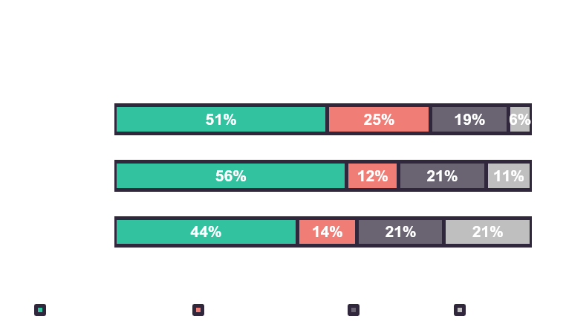
MOVE-ON - ENGLAND
Notes:
England’s move-on rate has improved slightly as it has every year since the pandemic.

Slide 26
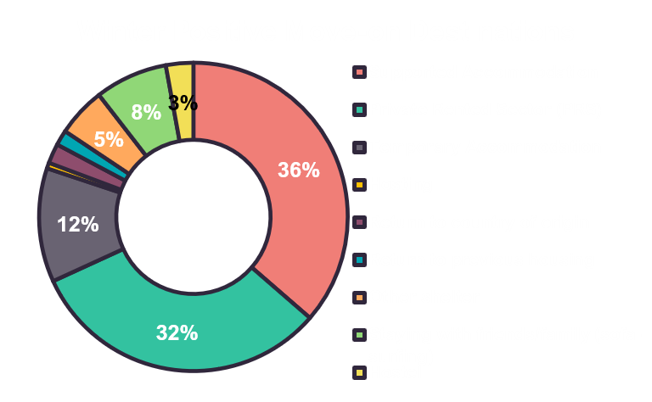
MOVE-ON DESTINATIONS
Notes:
Supported accommodation and the PRS are where the lions share of positive outcomes have occurred. - 68% in total

Slide 27
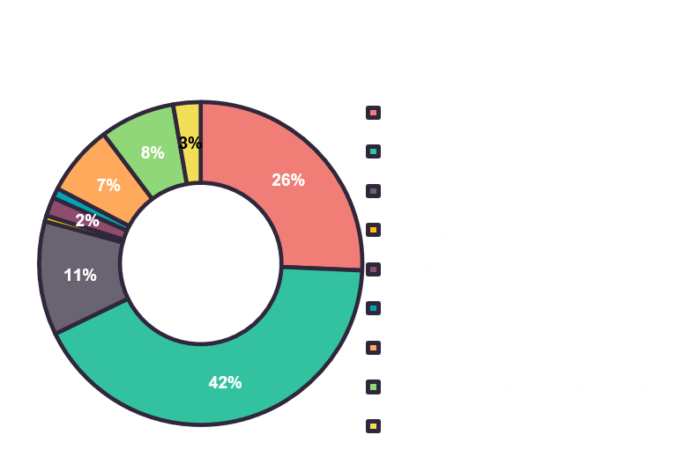
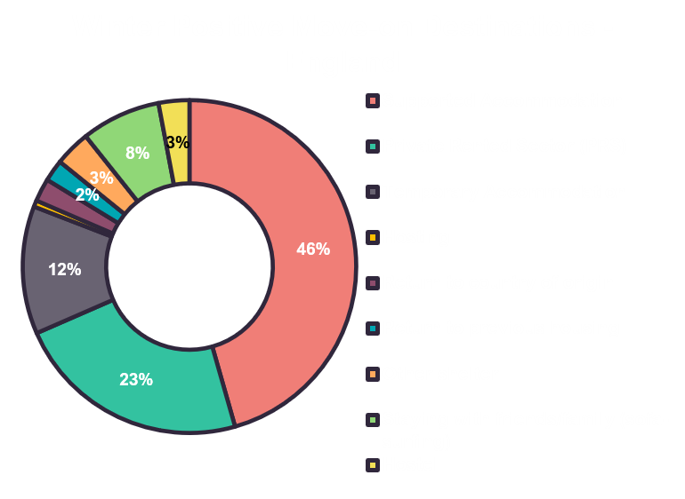
MOVE-ON DESTINATIONS – LDN/ENG
Notes:
London and England are flipped in terms of PRS and supported accommodation outcomes. We of course have the Lettings Network in full swing in London helping link guests up with available suitable properties in the PRS so this could be a contributing factor.

Slide 28
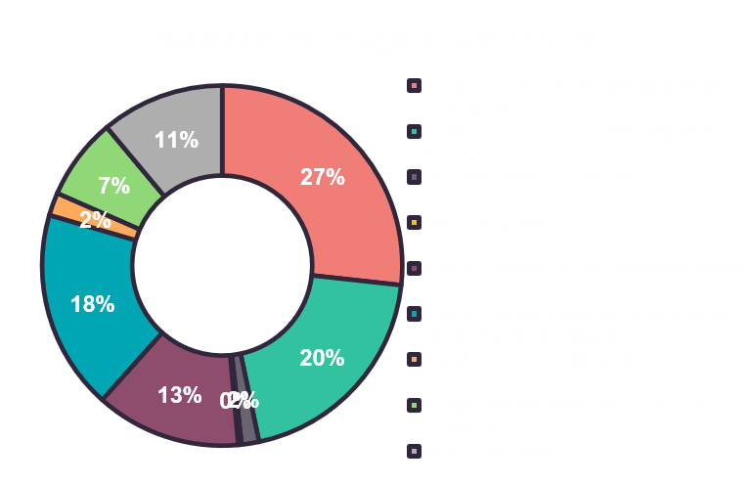
REASONS FOR NEGATIVE MOVE-ON
Notes:
Reasons for negative move-ons is a new dataset introduced this year. What it shows is that almost half of negative move-ons occur when a guest leaves on their own accord. After that guests being asked to leave shelters due to behaviour is the next leading cause at 18% followed by shelter closure at the end of the season at 13%. NRPF causes negative outcomes in 7% of cases.

Slide 29
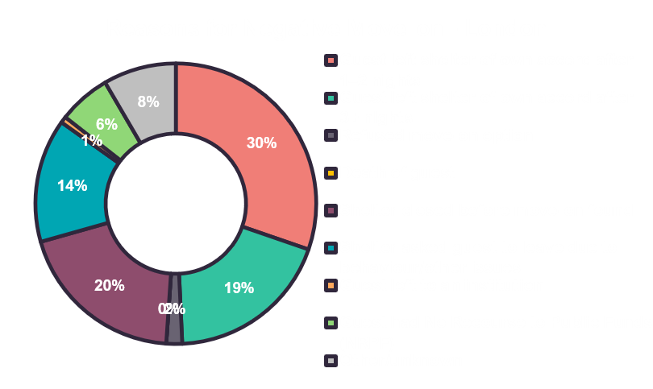
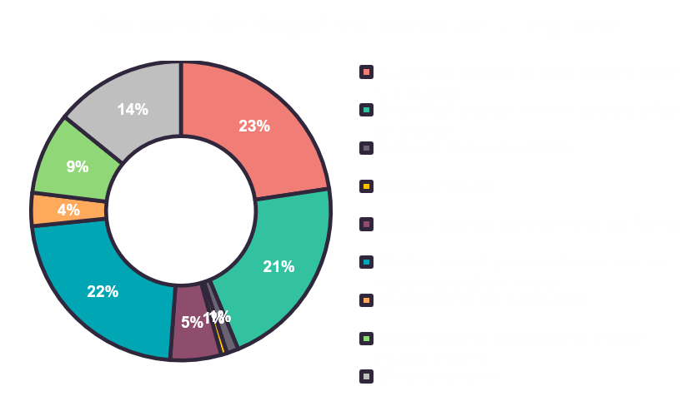
REASONS FOR NEGATIVE MOVE-ON – LDN/ENG
Notes:
Guests leaving of their own accord is more prominent in London, correlating with the number of communal shelters and the length of stay data associated with them. What is particularly interesting is England shelters have a much higher proportion of guests leaving due to poor behaviour than London. London has more cliff-edge occurrences where shelters close before move-ons are found. This could be associated with complex immigration cases not being complete or simply lack of move-on options.

Slide 30
ACCOMMODATION PROJECT TRENDS
Theme 1: Increasing Complexity of Guest Needs
Many shelters reported supporting people with multiple, overlapping needs including mental health issues, substance misuse, trauma, immigration concerns and complex behavioural issues
Theme 2: Lack of Suitable Move-on Options
The second most common theme was the difficulty of helping guests move into longer-term housing due to shortages of affordable accommodation and limited specialist housing options.

Slide 31
ACCOMMODATION PROJECT TRENDS
Theme 3: Volunteer Recruitment, Retention and Staffing Capacity
Many shelters struggled to recruit and retain volunteers, particularly for leadership and overnight roles. Staffing shortages also increased pressure on managers and existing teams.
Theme 4: Funding and Financial Pressures
Rising costs and insufficient funding were frequently cited by shelters, affecting service sustainability and growth.

Slide 32
ACCOMMODATION PROJECT TRENDS
Theme 5: Partnership, Referral and System Challenges
Many shelters described difficulties working within the wider homelessness systems, including Local Authorities, referral pathways and external services.
Theme 6: Language, Immigration and NRPF Issues
A recurring theme was supporting people facing language barriers, immigration issues and No Recourse to Public Funds (NRPF)
Theme 7: Behavioural Issues, Substance Misuse and Community Safety
Several shelters reported incidents involving substance misuse, anti-social behaviour, conflict and violence.

Slide 33
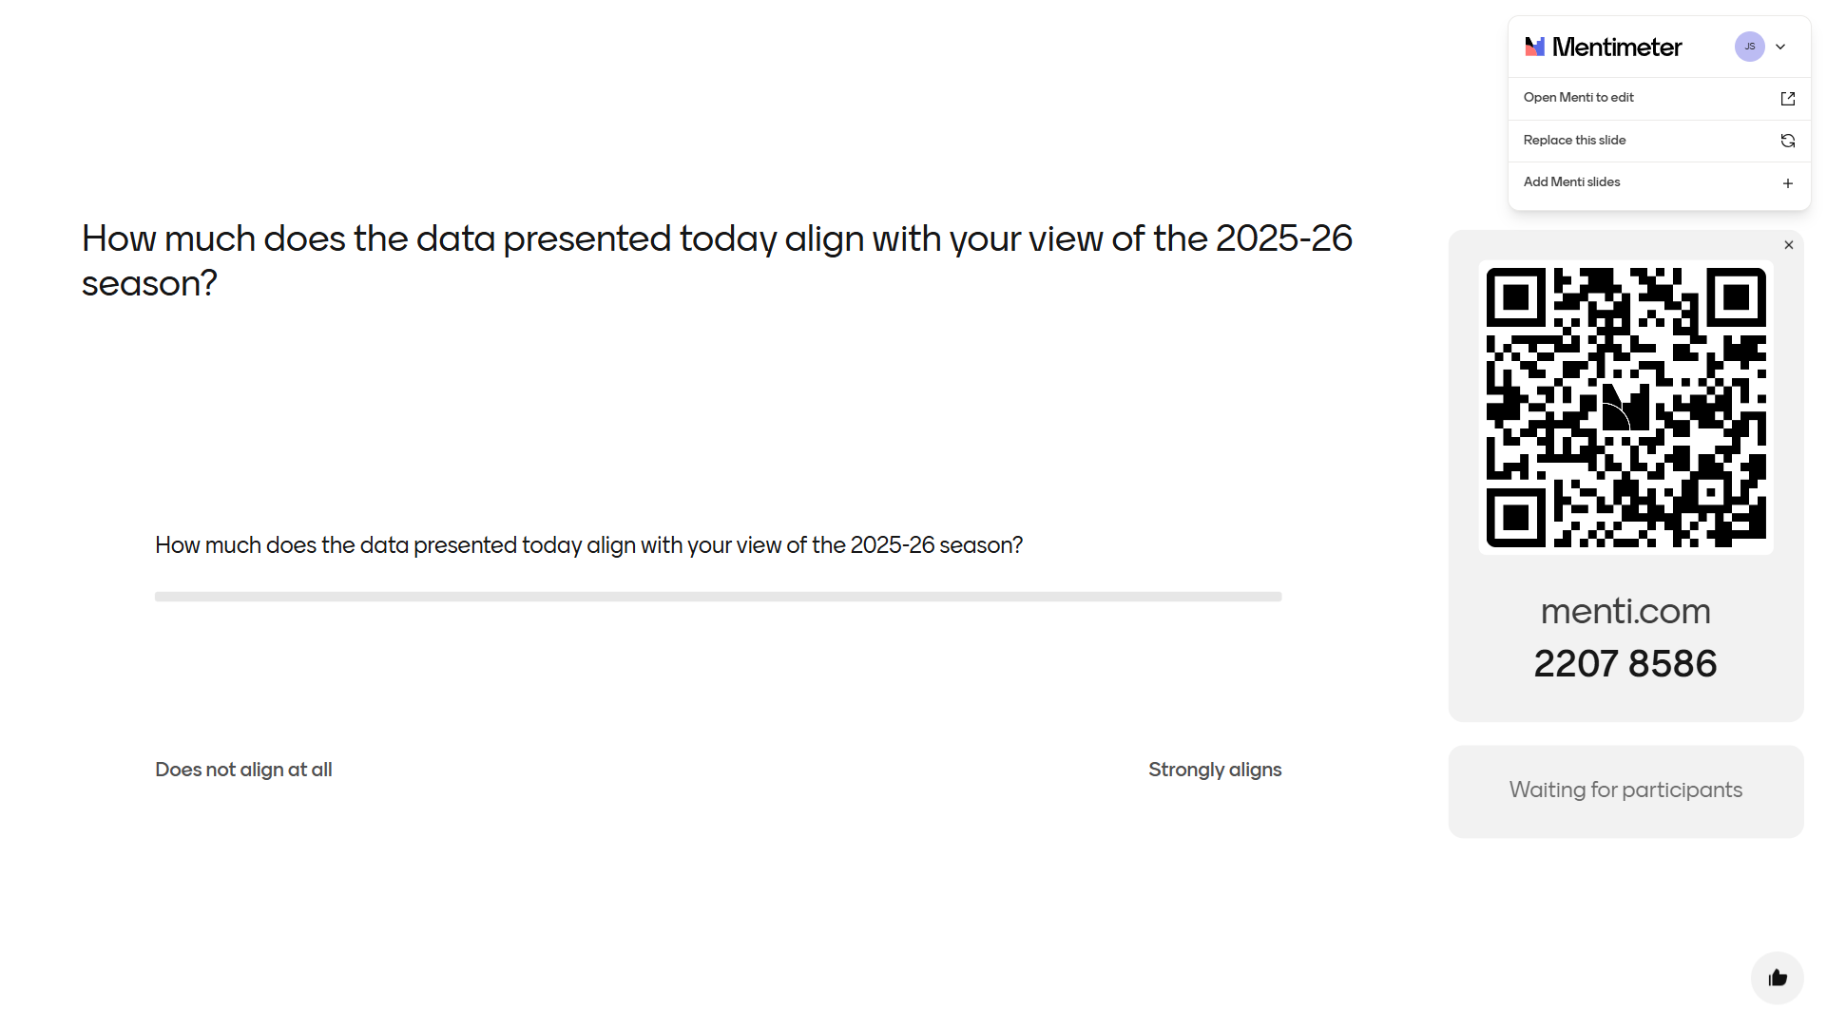
How much does the data presented today align with your view of the 2025-26 season?

Slide 34

CHARITY NUMBER | ENGLAND: 294666 | SCOTLAND: SC053819
HTTPS://HOUSINGJUSTICE.ORG.UK
@HOUSING JUSTICE

